Slide 1
Early life physiological and energetic responses of Atlantic silversides (Menidia menidia) to ocean acidification, warming, and hypoxia
Teresa G. Schwemmer

Slide 2


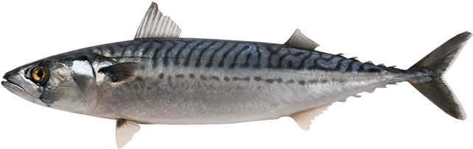
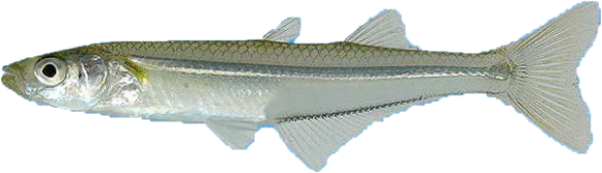
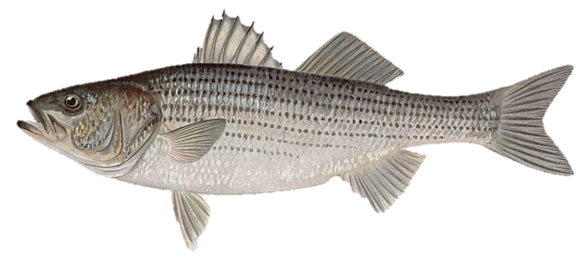
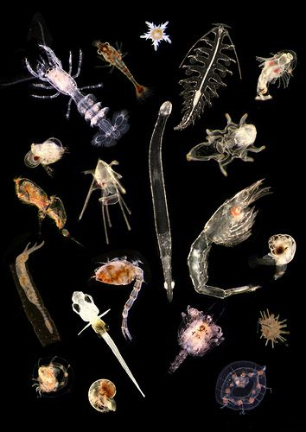
Atlantic silversides Menidia menidia
Notes:
-Atlantic silversides are mostly used as a baitfish by humans, but they are also a very abundant fish that is food for a wide variety of larger fish, birds, and marine mammals
-They eat plankton, so they are an important way for energy to make its way up the food web
-Their small size and short life cycle also makes them an ideal species. A good ‘average’ fish that has a lot in common with other species that aren’t as easy to do experiments on, so you can assume that their responses will apply to some other species too.
-Because of their ecological importance and use as a model species, it is important to understand how they respond to changing environmental conditions
And to figure out what those changes MEAN by looking at the underlying mechanisms

Slide 3
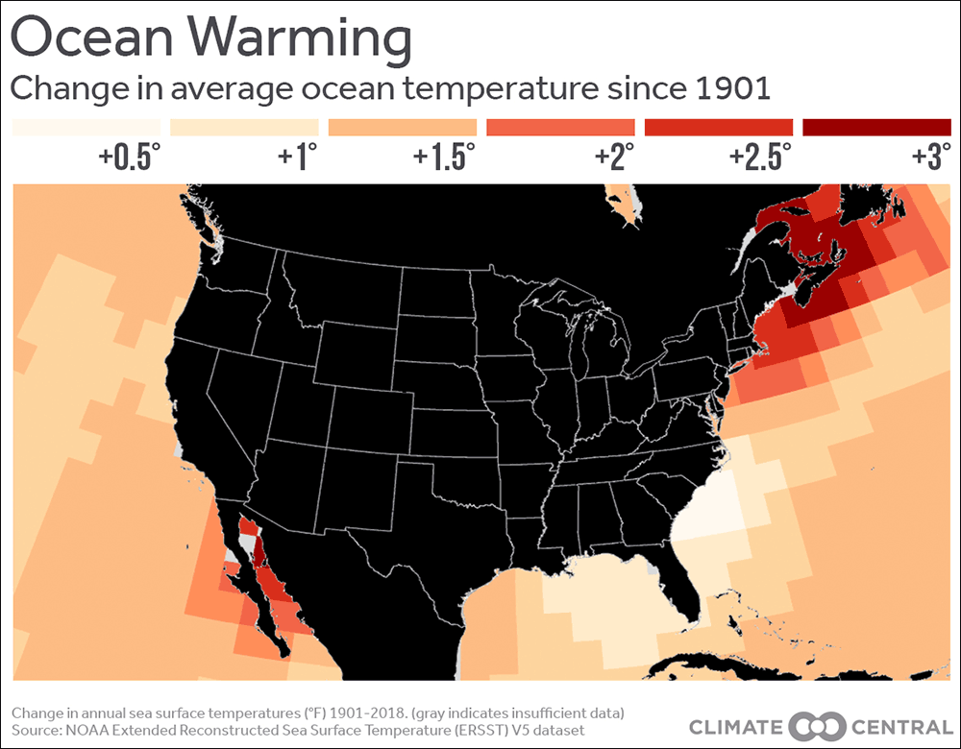
The Perfect Storm: Multiple Intensifying Stressors in Estuaries
OCEAN ACIDIFICATION
WARMING
HYPOXIA
Source: Climate Central
Notes:
-Silversides live in estuaries and coastal waters along the east coast, and the ones I did my research on are from bays and estuaries connected to Long Island Sound
-This area is experiencing a combination of gradual global changes and more intense, fluctuating conditions
-At the same time, the waters off the Northeast US are some of the fastest warming waters worldwide
-Long island is here – not as bad as Gulf of Maine and north but still has warmed by about 2 or more degrees FAHRENHEIT

Slide 4
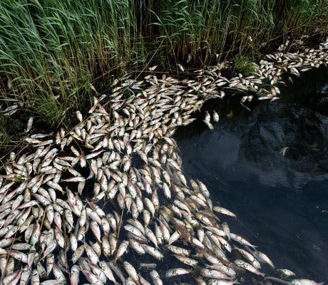
The Perfect Storm: Multiple Intensifying Stressors in Estuaries
OCEAN ACIDIFICATION
WARMING
HYPOXIA
Source: NY Times
Notes:
-Warmer water holds less dissolved oxygen
-This is contributing to widespread ocean deoxygenation worldwide, and hypoxic ‘dead’ zones that cause fish kills like this are becoming more common

Slide 5
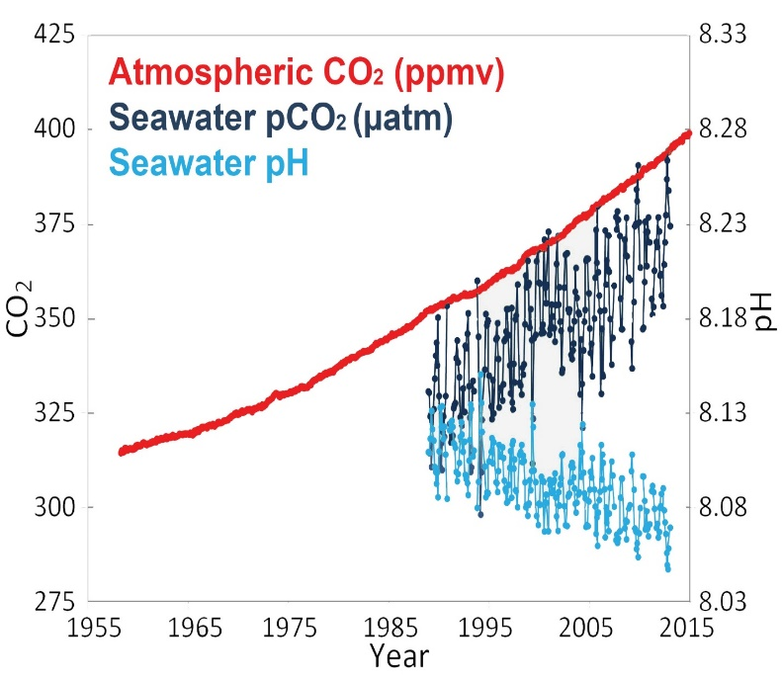
The Perfect Storm: Multiple Intensifying Stressors in Estuaries
OCEAN ACIDIFICATION
WARMING
HYPOXIA
Source: NOAA
Notes:
-Ocean acidification is gradually decreasing the pH in the ocean worldwide. As CO2 from GHG emissions dissolves into the water, CO2 goes up and pH goes down.
-Just like soda, the colder the water is the more CO2 it can hold. So the farther you are from the equator the more severe ocean acidification is.

Slide 6
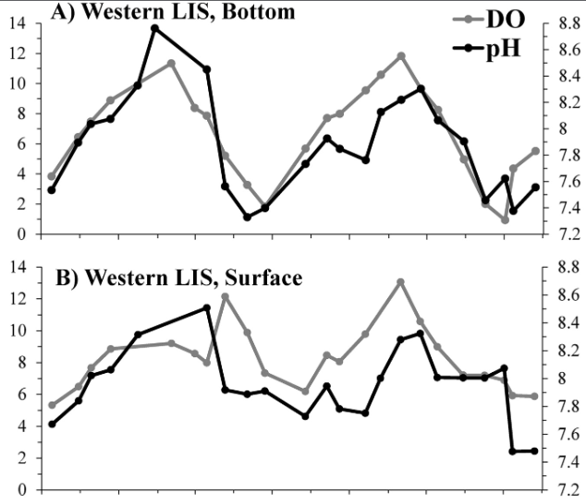
Conditions are even more severe in estuaries, where young silversides live
Oxygen and pH fluctuate together
Contributing factors:
Stratification
Community respiration
Particulate organic matter and decomposition
*Fully oxygenated is ~8 mg/L
*Open ocean pH is ~8.1
Dissolved oxygen (mg L⁻¹)
pH
Wallace et al., 2014
Notes:
-In estuaries, which silverside offspring use as a nursery, these changes are happening on top of highly fluctuating and extreme conditions
-Warming causes stratification that can trap hypoxic waters at the bottom and prevent surface oxygen from reaching the bottom
-Coastal waters have a lot of respiration going on – both from densely populated marine life and microbial respiration from decomposition of organic matter
-The closed-in shapes of some estuaries can delay mixing with outside seawater to help dissipate the acidified, hypoxic water that forms
-As a result, pH and oxygen tend to covary – as shown here for western Long Island sound
-Summer is when both of these stressors are at their worst, especially in bottom waters (DO is below 2 mg/L and pH is almost a whole unit below that of the open ocean, which is about 10x as acidic because it is on a log scale)

Slide 7
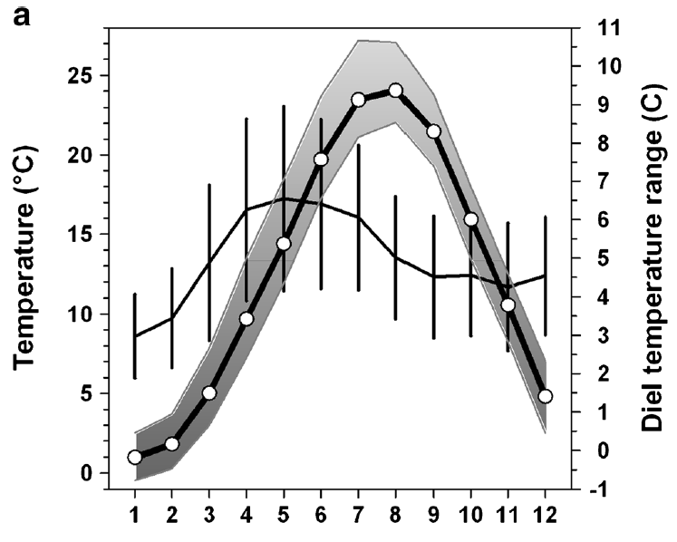
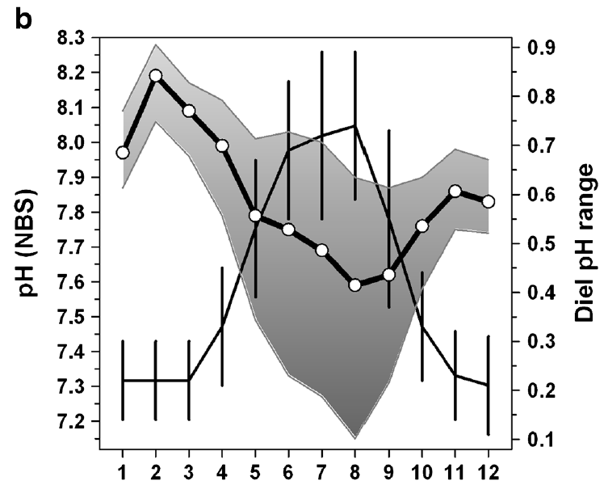
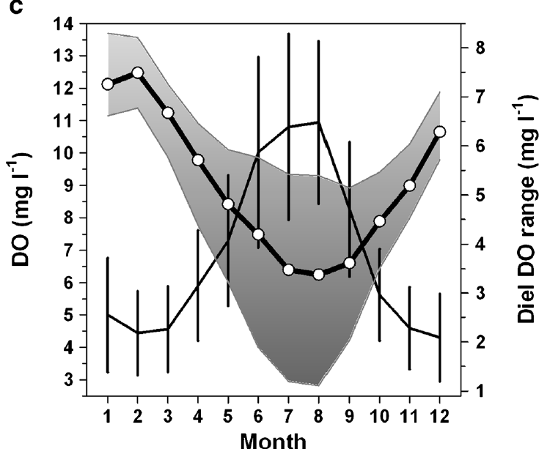

Conditions are even more severe in estuaries, where young silversides live
Baumann et al., 2015
Summer conditions exceed projections for global change
Notes:
-This is data from Flax Pond, a very enclosed salt pond off of LIS
-The thick black line and gray shading show the temperature, pH, or DO in the pond throughout the year
-The thin black line shows the daily range of each variable so you can see how much higher the variability is in spring and summer, especially for pH and DO
-When temperatures get highest is also when pH and oxygen get lowest
-Silversides are already experiencing conditions more severe than those predicted for global change, and they experience multiple stressors at once
-This means to understand their tolerance realistically, we need to study the effects of multiple stressors at the same time

Slide 8
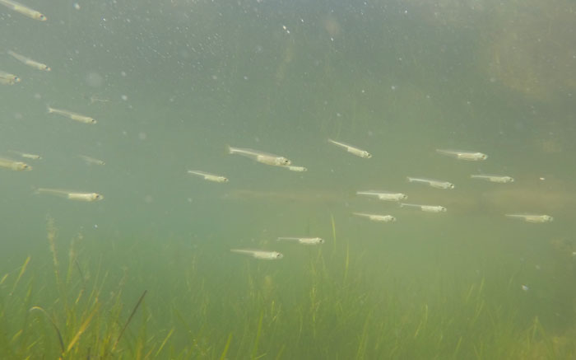
Early life stages least mobile
Nursery habitats experience great fluctuations
How does early life exposure to stressors affect Atlantic silversides?
Photo: Brian Leuchtenburg, FishersIsland.net
Notes:
-Silversides are already experiencing conditions more severe than those predicted for global change
-The early life stages, which are thought to be more sensitive to stressors, experience multiple stressors at once in their habitat
-This means to understand their tolerance realistically, we need to study the effects of multiple stressors at the same time

Slide 9
Interacting effects

Slide 10
Interacting effects

Slide 11
Interacting effects
Notes:
-You can also have interactions where a treatment by itself has no effect but when you add an additional stressor, it starts to have an effect

Slide 12
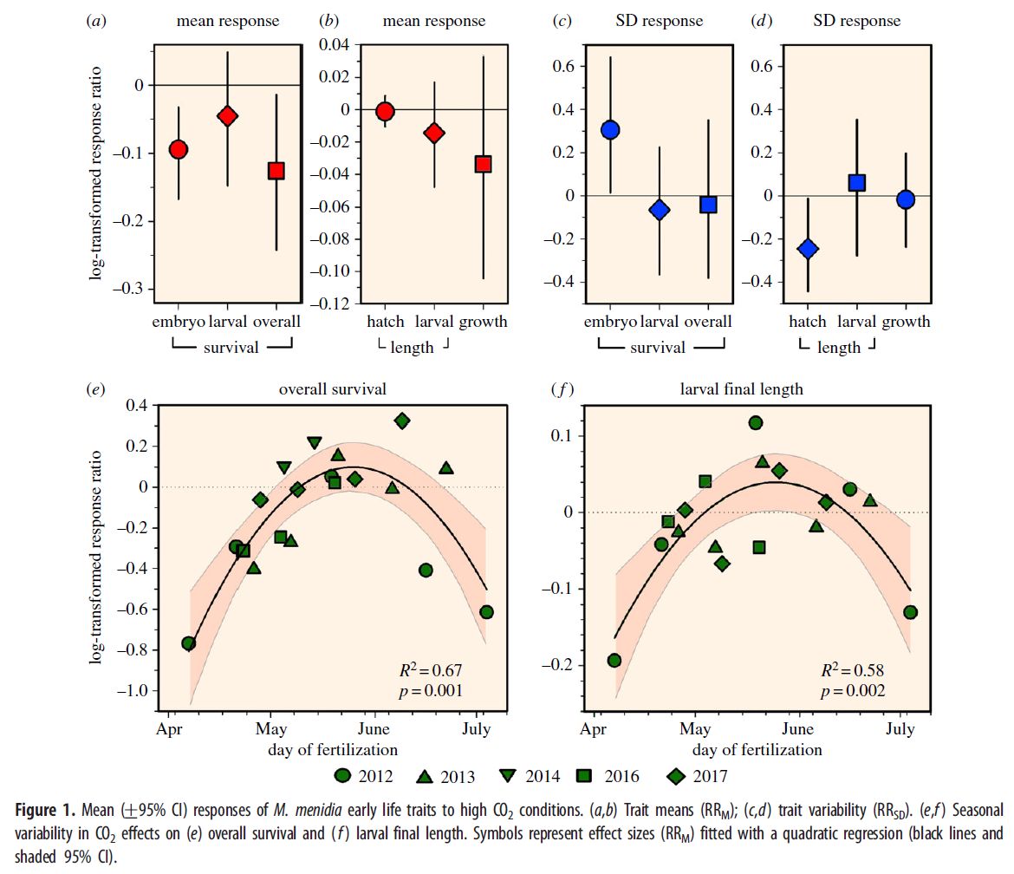
Variable responses to acidification have been observed
Survival
Growth
No effect near line
Negative effects sometimes
Baumann et al. (2018), Biology Letters

Slide 13
Variable responses to acidification have been observed
Survival
Growth
What are the underlying physiological mechanisms?
No effect near line
Negative effects sometimes
Baumann et al. (2018), Biology Letters
Notes:
-What still hadn’t been looked at, for silversides as well as many other species, is what the underlying mechanisms are.
-How are they compensating for low pH and other co-occurring stressors?
-What physiological mechanisms help them tolerate it, and what tradeoffs might be occurring that are harmful to things like growth, recruitment, and reproduction?
-This can help us understand how populations and ecosystems will be affected as well

Slide 14
Objectives
Chapter 1: Measure metabolic effects of CO₂, temperature, and oxygen treatments
Chapter 2: Does acidification alter metabolic response to progressive, acute hypoxia?
Chapter 3: Identify mechanism of pH regulation in early life stages across CO₂ and temperature levels
Chapter 4: Attribute early life hypoxia responses to energetic mechanisms using a Dynamic Energy Budget

Slide 15
Outline
Chapter 1: Measure metabolic effects of CO₂, temperature, and oxygen treatments
Chapter 2: Does acidification alter metabolic response to progressive, acute hypoxia?
Chapter 3: Identify mechanism of pH regulation in early life stages across CO₂ and temperature levels
Chapter 4: Attribute early life hypoxia responses to energetic mechanisms using a Dynamic Energy Budget

Slide 16
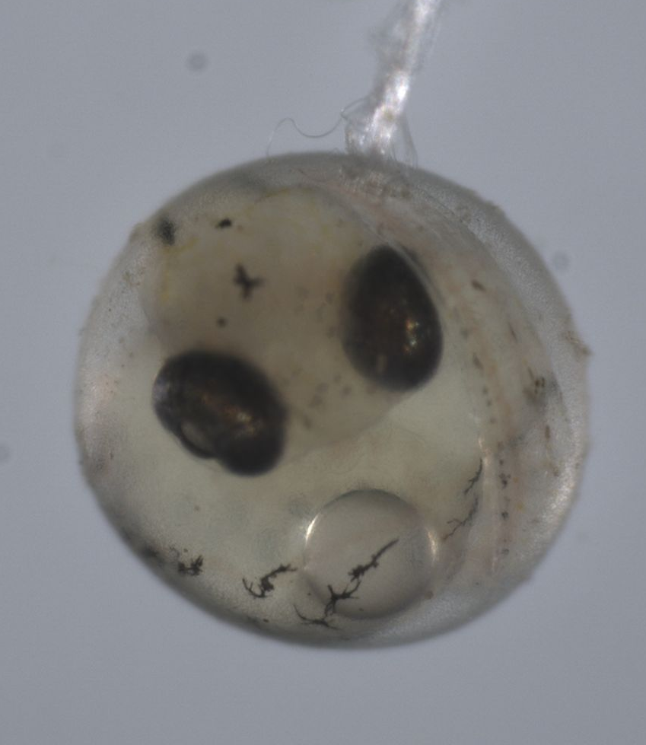
Chapter 1: Metabolic rates of offspring exposed to CO₂, temperature, and oxygen treatments
Experimental design
Two types of experiments conducted by Baumann Lab at UConn:
Temperature x CO₂
Oxygen x CO₂
Catch wild adults and spawn in lab
Start treatments right after fertilization
M. medina embryo

Slide 17
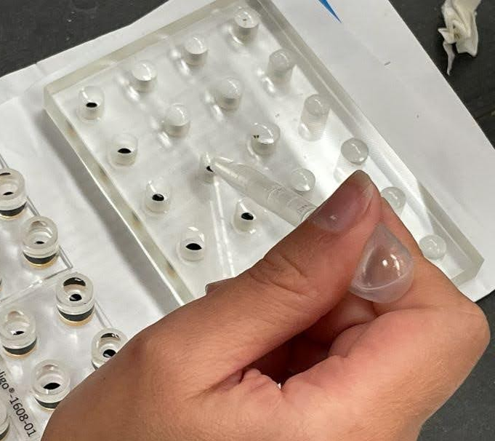
Chapter 1: Metabolic rates of offspring exposed to CO₂, temperature, and oxygen treatments
Objective:
Understand metabolic costs of stressors for:
Embryos
Newly hatched larvae
Measure mechanism of impacts on growth and survival
Respirometry wells

Slide 18
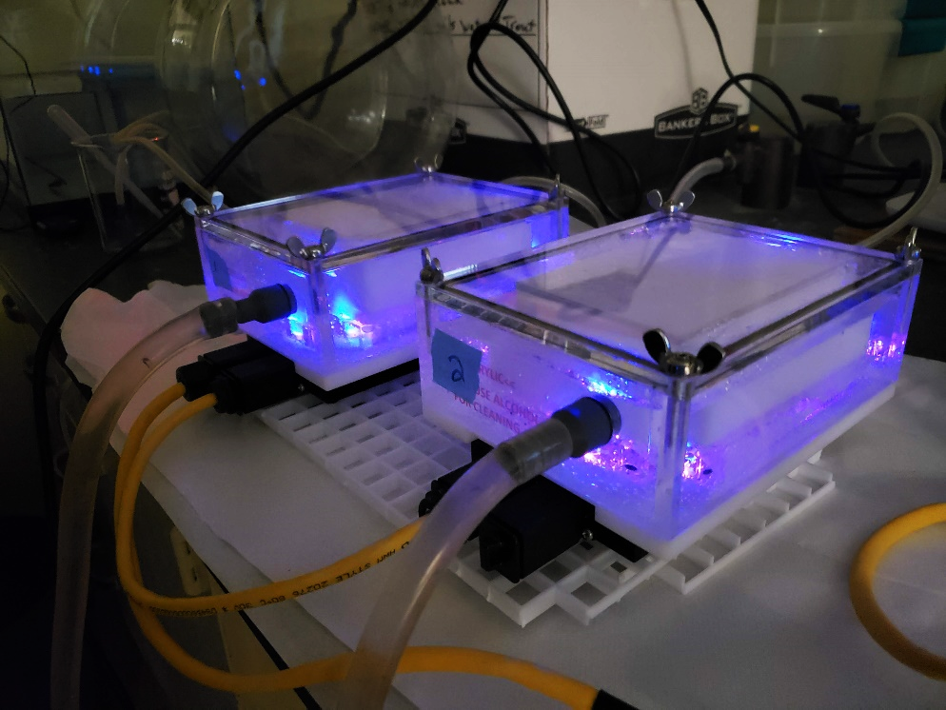
Chapter 1: Metabolic rates of offspring exposed to CO₂, temperature, and oxygen treatments
Hypotheses:
Metabolism increases with warmer temperatures
Metabolism increases with acidification
Metabolism decreases with low oxygen
Optical oxygen measurement

Slide 19
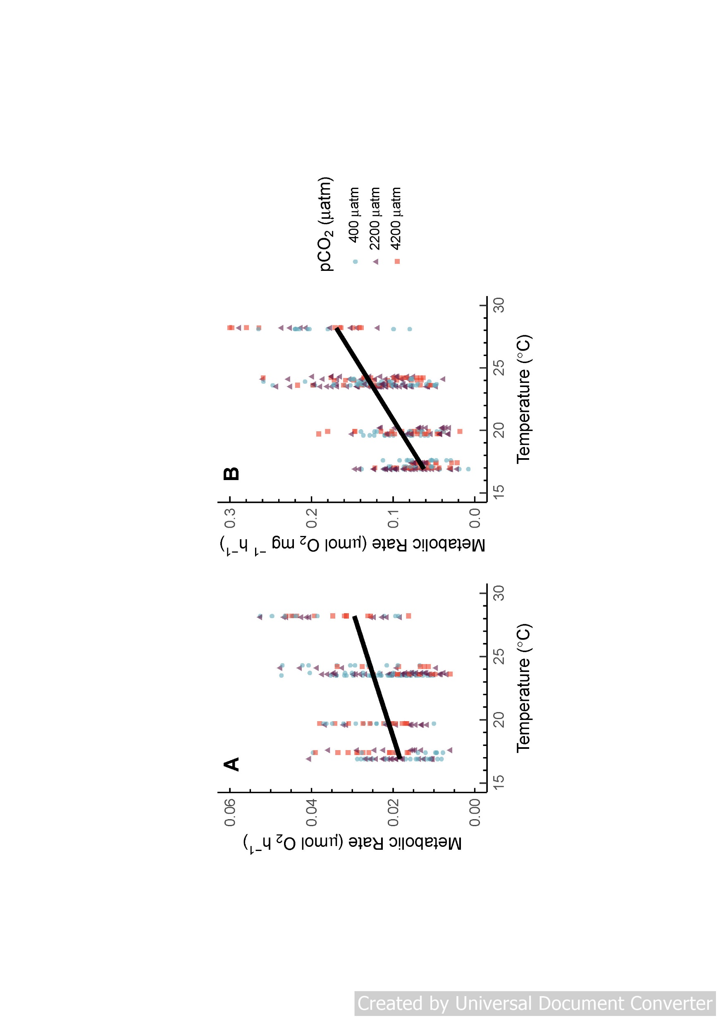
Chapter 1 Results: Temperature × CO₂
Embryos
Larvae
Only temperature affects metabolism
Schwemmer et al. (2020), J. Exp. Biol.
Notes:
-Analyzed four experiments combined with linear regression, to test for significant effect of CO2 or Temperature or their interaction
-Found no effect of CO2, but a significant increase in metabolism with temperature – as expected.

Slide 20
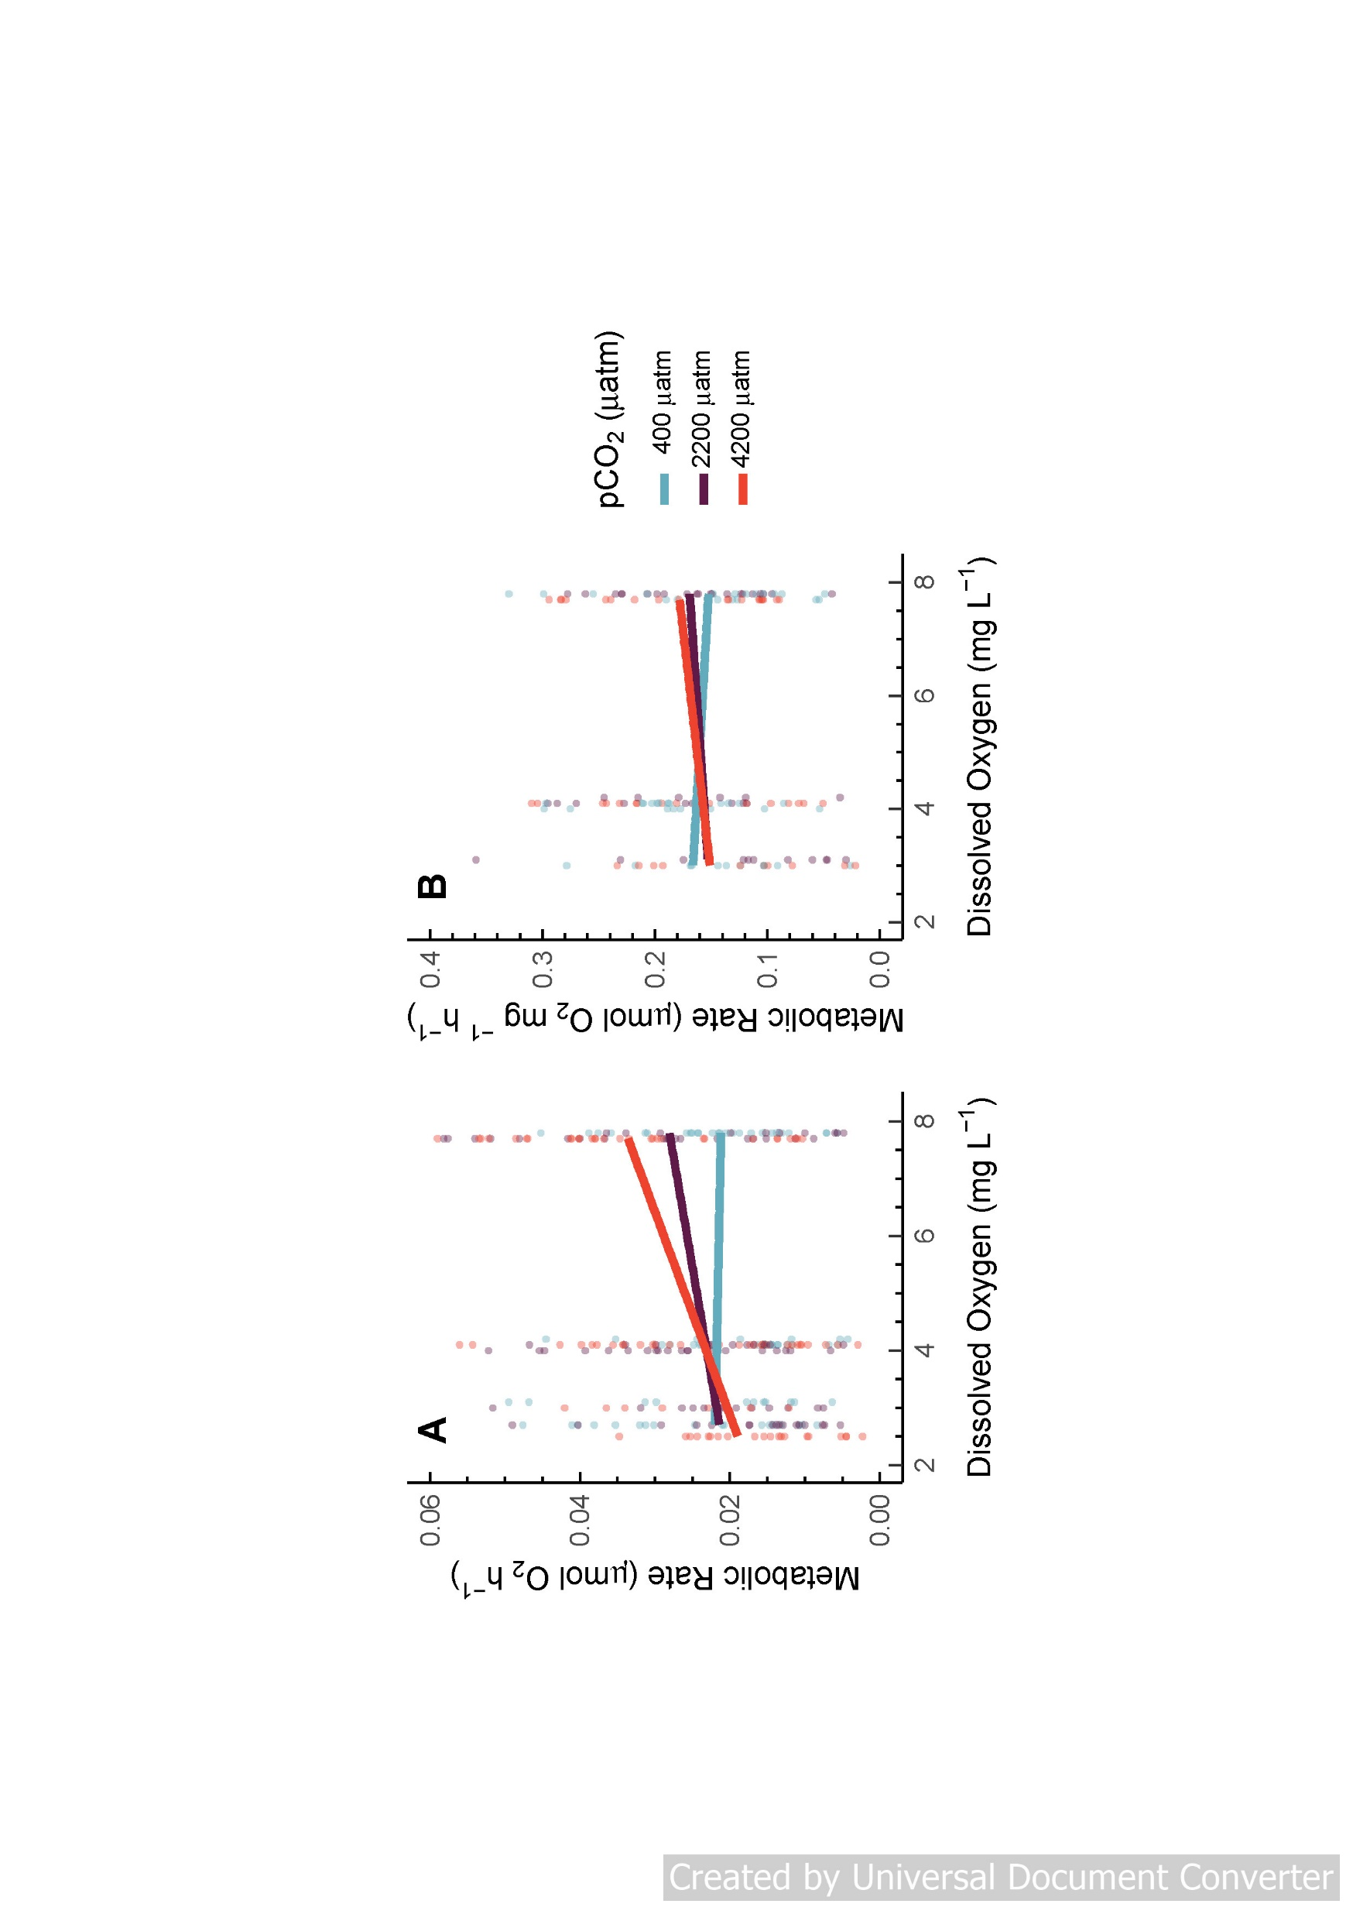
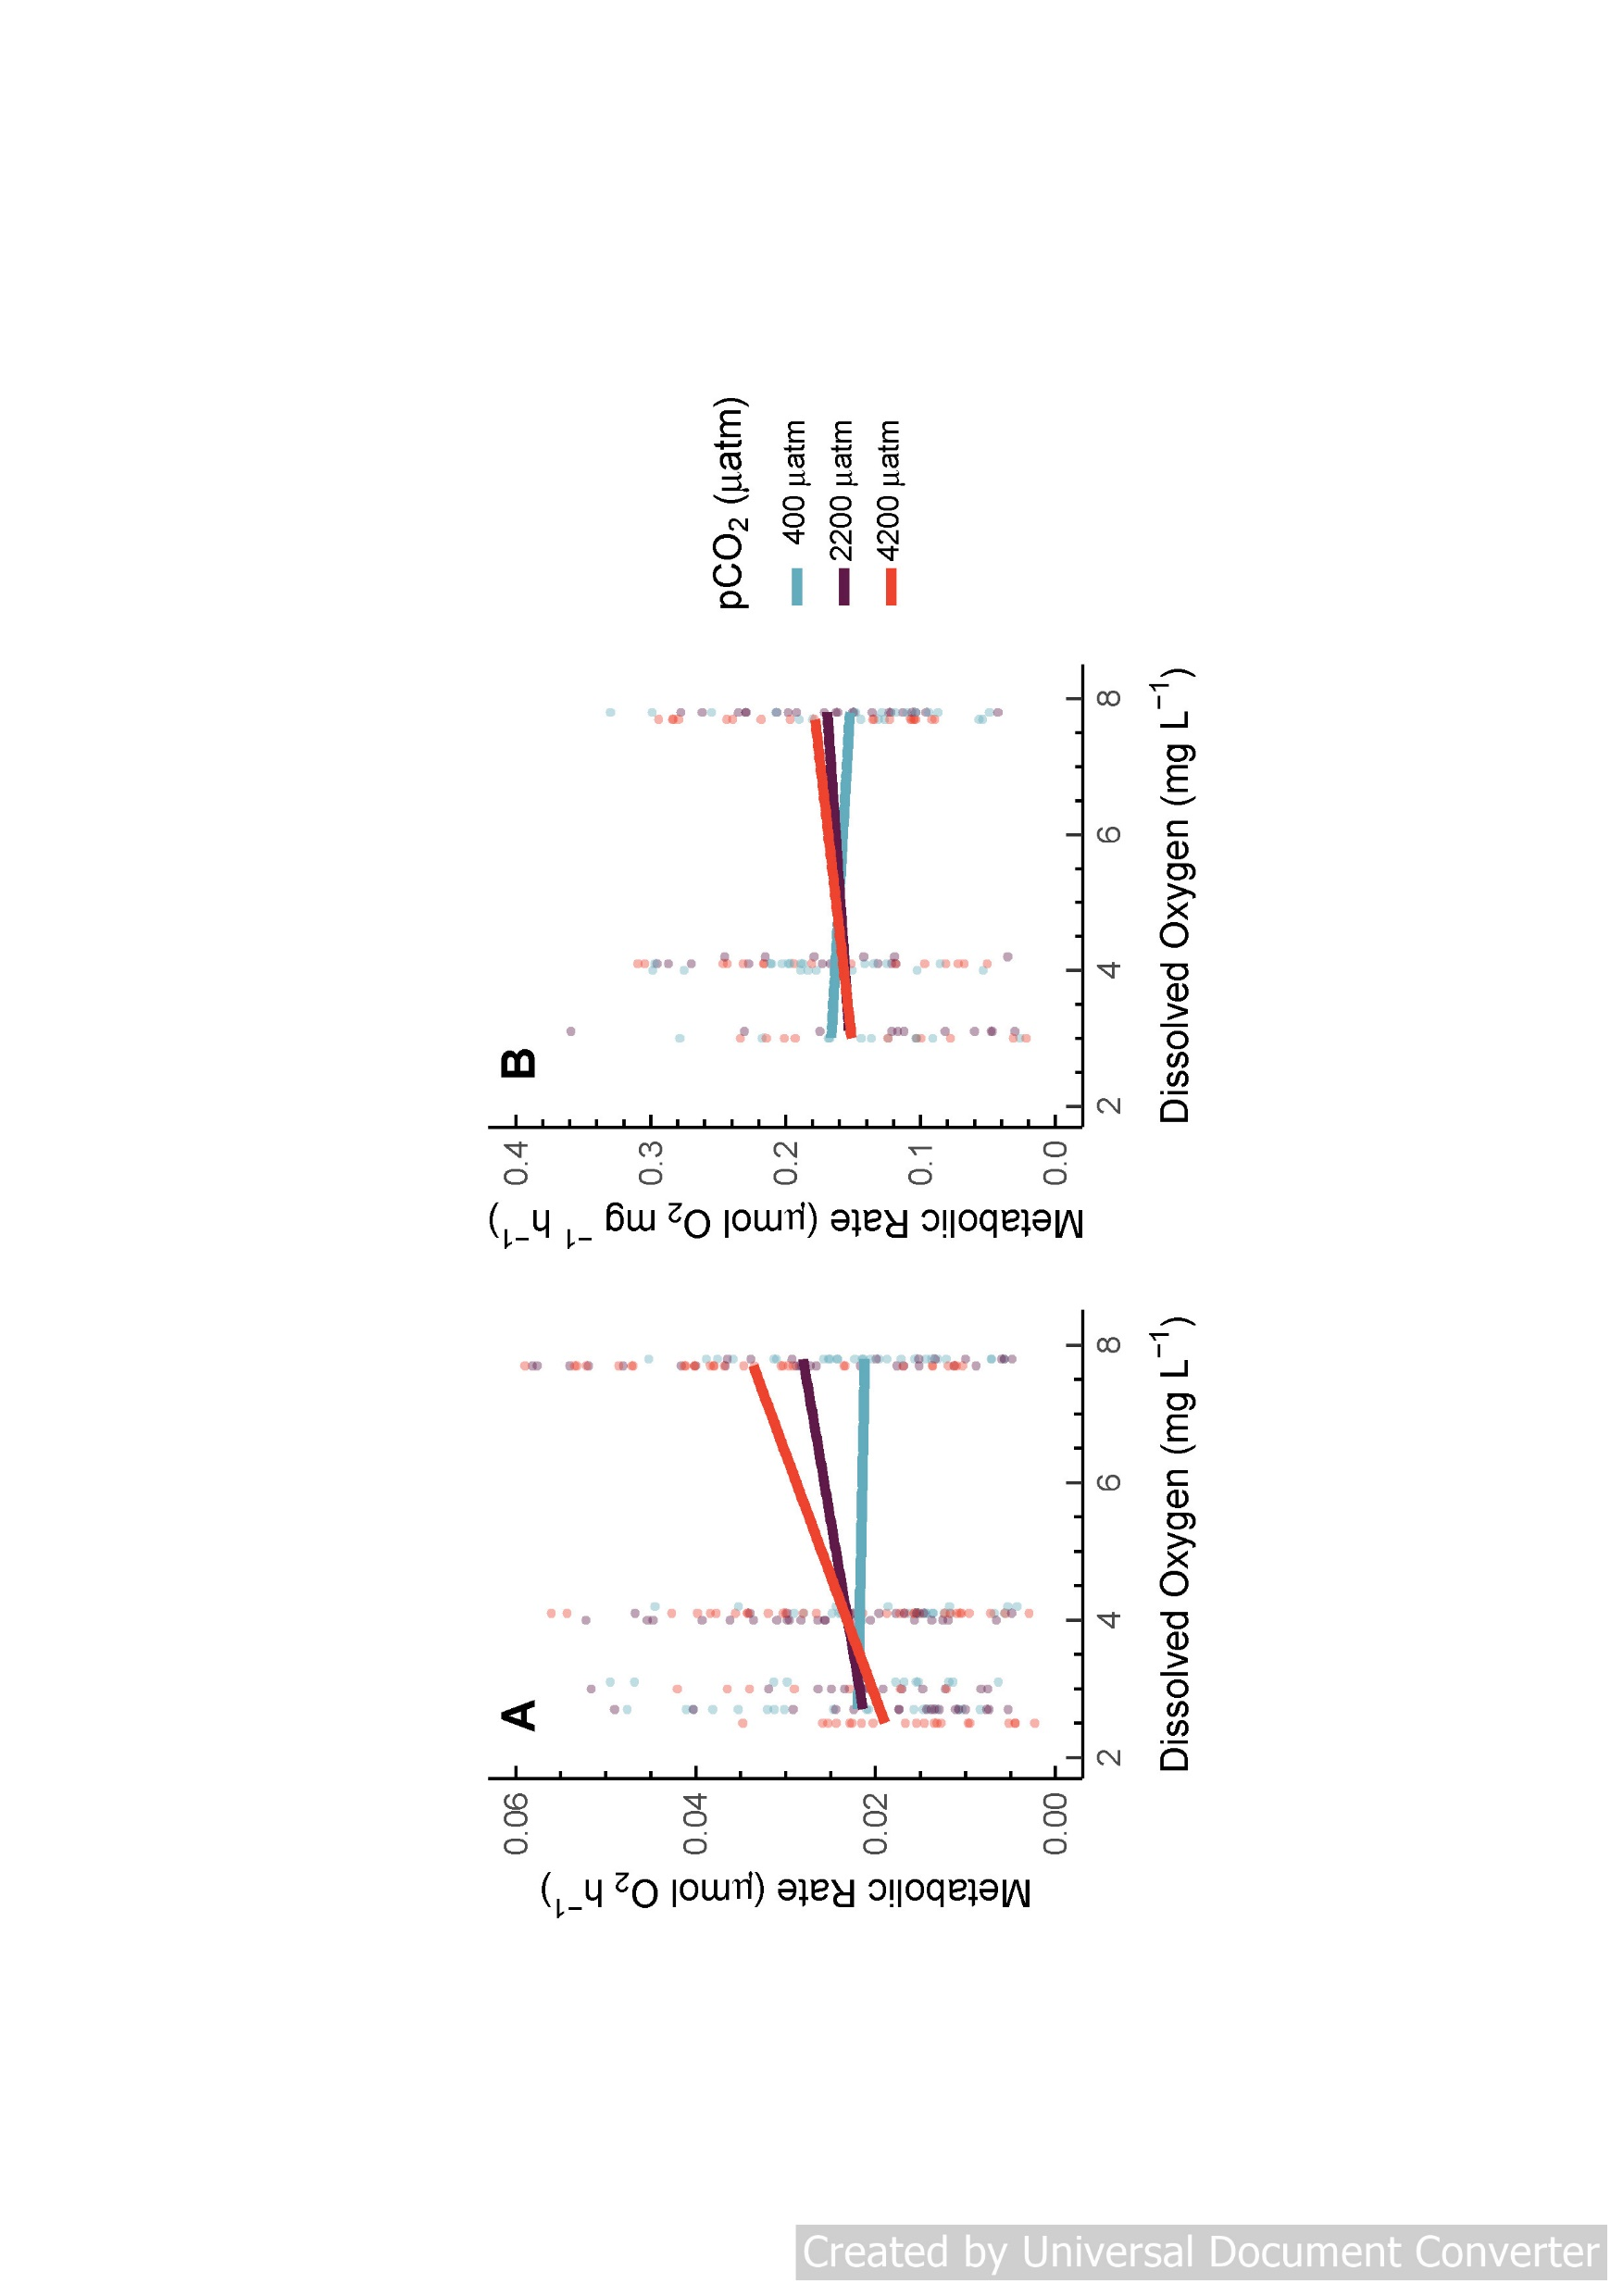
Interacting hypoxia and acidification
Embryos
Ambient CO₂: unaffected by hypoxia
Medium and High CO₂: increasingly hypoxia-sensitive
High CO₂ metabolic rates ~30% greater than ambient CO₂ in normoxia
Schwemmer et al. (2020), J. Exp. Biol.
Notes:
-In the two experiments with oxygen and CO₂, we found a significant interaction between oxygen and CO₂
-

Slide 21
Embryos affected, but not larvae
Chapter 1 Results: Oxygen × CO₂
Embryos
Larvae
Schwemmer et al. (2020), J. Exp. Biol.
Notes:
-However we did not see such an interaction for larvae
-Mention that we didn’t have larvae for the lowest DO level because none survived hatching.

Slide 22
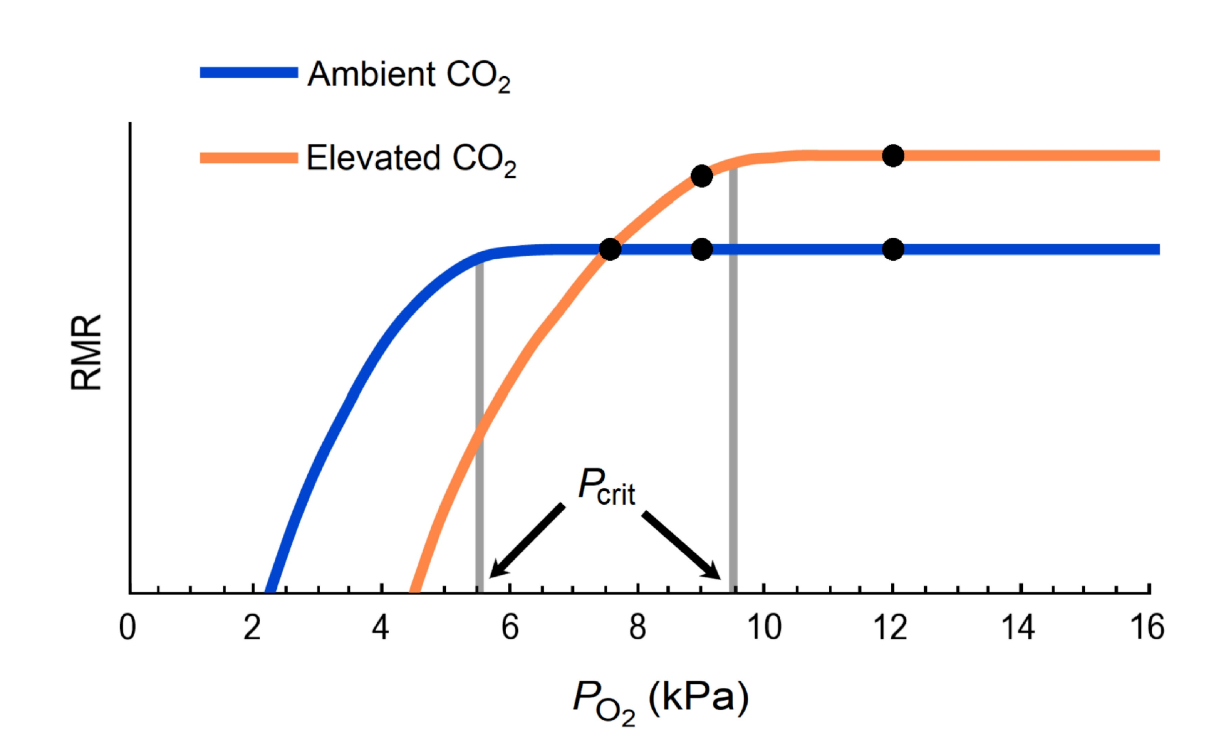
Digging deeper into the Oxygen x CO₂ interaction
Hypothesized Interaction Between CO₂ & Hypoxia
Original Experimental Oxygen Levels
Embryos are more sensitive
High CO₂ by itself has little effect on metabolism
Acidification may alter response to hypoxia

Slide 23
Outline
Chapter 1: Measure metabolic effects of CO₂, temperature, and oxygen treatments
Chapter 2: Does acidification alter metabolic response to progressive, acute hypoxia?
Chapter 3: Identify mechanism of pH regulation in early life stages across CO₂ and temperature levels
Chapter 4: Attribute early life hypoxia responses to energetic mechanisms using a Dynamic Energy Budget

Slide 24
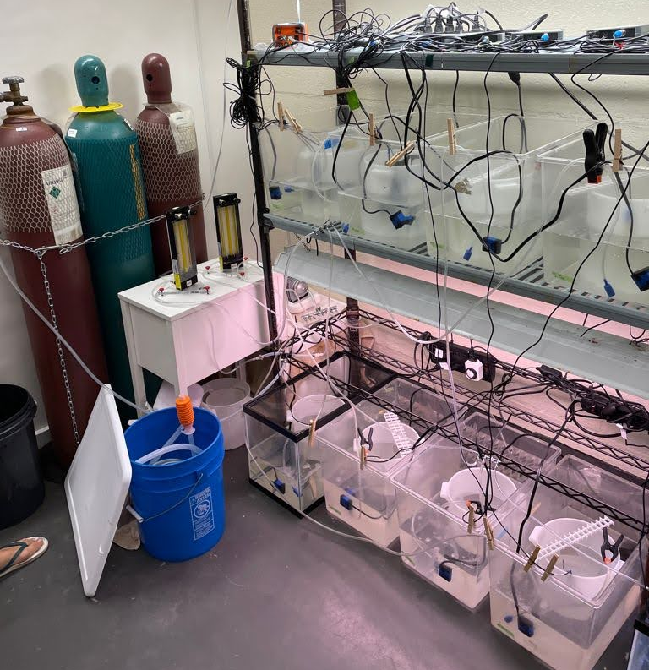
Chapter 2: Does acidification alter metabolic response to progressive, acute hypoxia?
Objective
Measure how CO₂ affects sensitivity to hypoxia.
Methods
Reared M. menidia at three CO₂ levels.
Respirometry on:
Embryos
2 day-post-hatch larvae
5 day-post-hatch larvae
Let oxygen reach ~0 and calculate P_{crit}

Slide 25
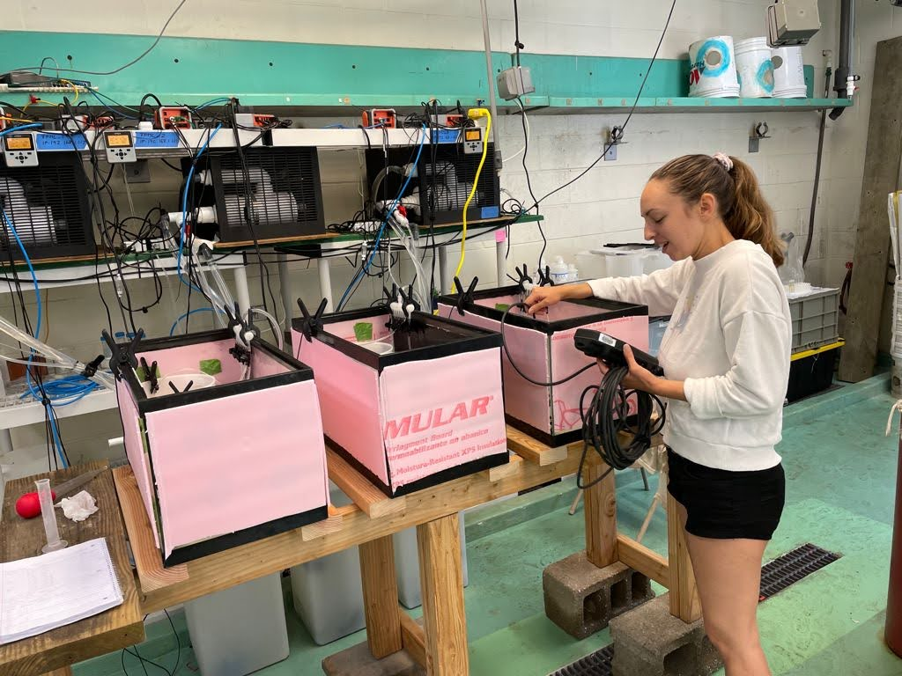
Chapter 2: Does acidification alter metabolic response to progressive, acute hypoxia?
Hypotheses
Metabolism increases with high CO_{2.}
High CO₂ increases P_{crit} (hypoxia sensitivity)

Slide 26
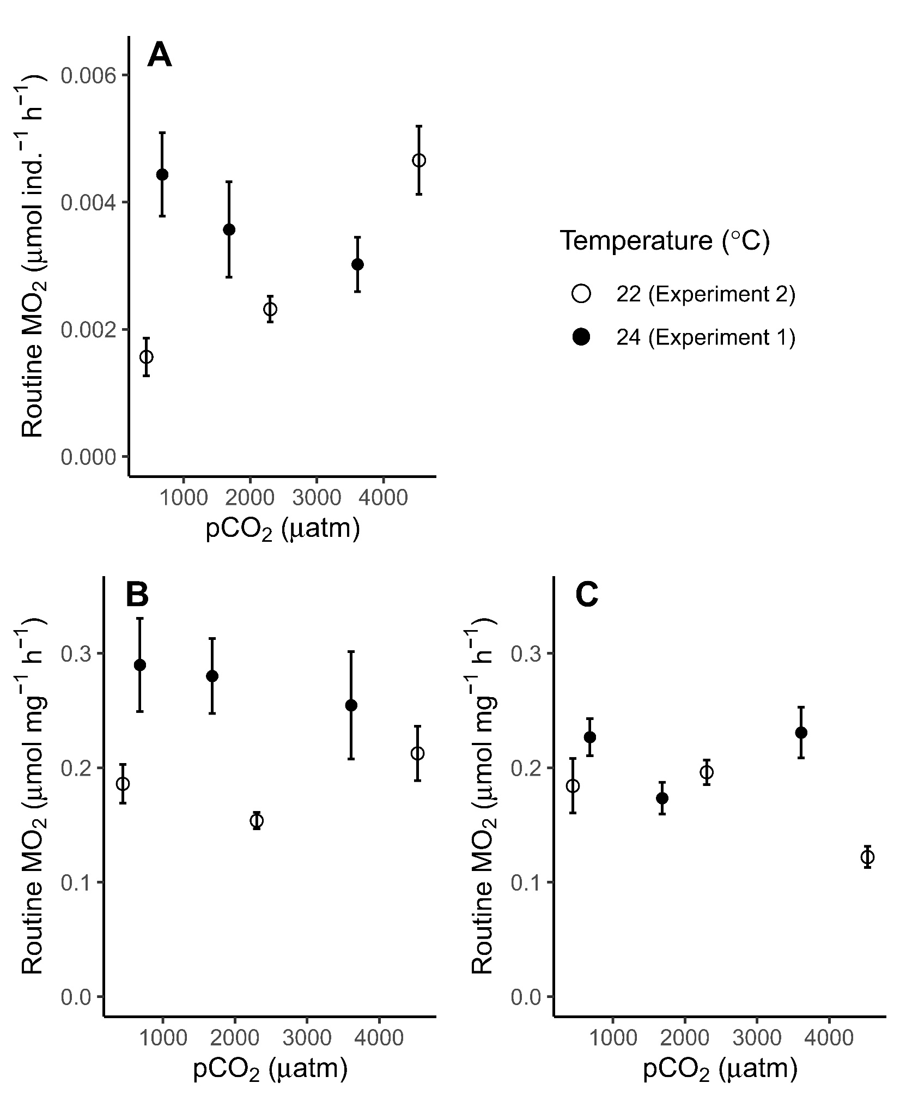
Chapter 2 Results: Metabolic Rates
Embryos
*
*
Opposite responses in embryos and larvae
Only affected at 22°C
Varying CO₂ treatments may have played a role
2 days-post-hatch
5 days-post-hatch
*
*
 | pH |  |  | pCO₂ (µatm)
 | Amb | Mod | High | Amb | Mod | High
Exp. 1 | 7.94 | 7.41 | 7.13 | 680 | 1683 | 3609
Exp. 2 | 8.08 | 7.39 | 7.09 | 442 | 2299 | 4531
*
= significantly different groups
Notes:
Explain letters
Only Exp 2 (22C) were affected – maybe because the high CO2 level is higher in that experiment, maybe a threshold between 3600 and 4200
The method used to acidify the treatments in
pH
pCO₂ (µatm)
Temperature (°C)
Amb
Mod
High
Amb
Mod
High
Target levels
8.1
7.5
7.2
450
2000
4000
24 (Exp. 1),
22 (Exp. 2)
Exp. 1
7.94
7.41
7.13
680.0
1683.0
3609.1
23.8
Exp. 2
8.08
7.39
7.09
441.7
2299.2
4530.9
22.3

Slide 27
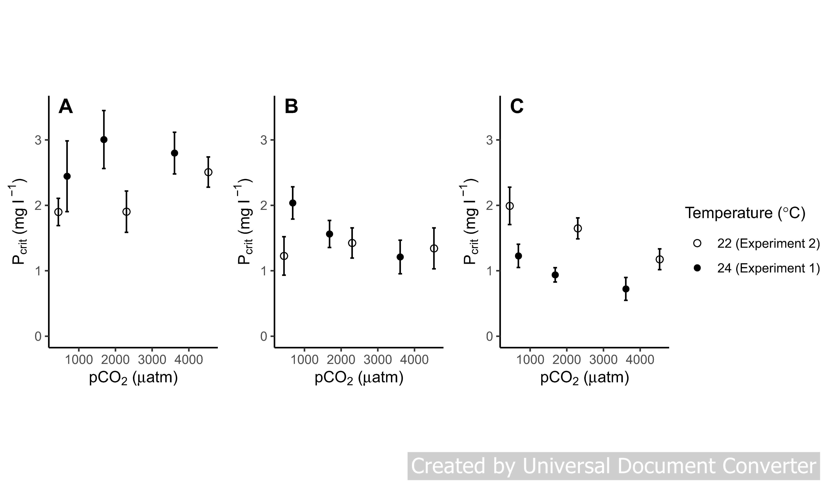

Chapter 2 Results: Critical Oxygen Level
Embryos
2dph Larvae
5dph Larvae
*Lower P_{crit} means less sensitive to hypoxia
*
*
*
Embryo P_{crit} is not affected by acidification
Surprisingly, larval P_{crit} decreases with acidification
Possible survivor effect – more sensitive ones died at hatching?
Notes:
Explain letters
Only Exp 2 (22C) were affected – maybe because the high CO2 level is higher in that experiment, maybe a threshold between 3600 and 4200
The method used to acidify the treatments in
pH
pCO₂ (µatm)
Temperature (°C)
Amb
Mod
High
Amb
Mod
High
Target levels
8.1
7.5
7.2
450
2000
4000
24 (Exp. 1),
22 (Exp. 2)
Exp. 1
7.94
7.41
7.13
680.0
1683.0
3609.1
23.8
Exp. 2
8.08
7.39
7.09
441.7
2299.2
4530.9
22.3

Slide 28
Ch. 1 Conclusions
Embryos are more sensitive
High CO₂ by itself has little effect on metabolism
Acidification may alter response to hypoxia

Slide 29
Ch. 1 and 2 Conclusions
Embryos are more sensitive than larvae
Embryo metabolism increases at highest CO₂ level
Temperature-dependent response
P_{crit} decreases at high CO₂ after hatching – possible advantage for dealing with both stressors
Refutes hypothesis from Chapter 1
Alt. explanation: CO₂ x Oxygen interaction suggests hypoxia impairs embryos’ ability to expend energy regulating pH

Slide 30
Outline
Chapter 1: Measure metabolic effects of CO₂, temperature, and oxygen treatments
Chapter 2: Does acidification alter metabolic response to progressive, acute hypoxia?
Chapter 3: Identify mechanism of pH regulation in early life stages across CO₂ and temperature levels
Chapter 4: Attribute early life hypoxia responses to energetic mechanisms using a Dynamic Energy Budget
Notes:
-My third chapter I looked at a mechanism of pH regulation to get at the mechanisms that may help early life stages be largely tolerant of high CO2 and low pH

Slide 31
Chapter 3: Ionoregulatory responses to seawater acidification and temperature
Objective
Understand how acidification affects physiological mechanisms of acid-base balance
Test across a range of temperatures
Temperature affects developmental rate
Method
Stain skin ionocytes and count them
Use same fish from Ch. 1 (metabolism)

Slide 32

Ocean Acidification & Fish
CO₂
↓pH
H⁺ excreted from gills
Strong regulation
Buffers
in blood

Slide 33
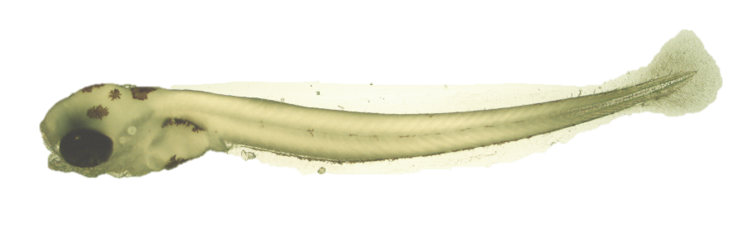
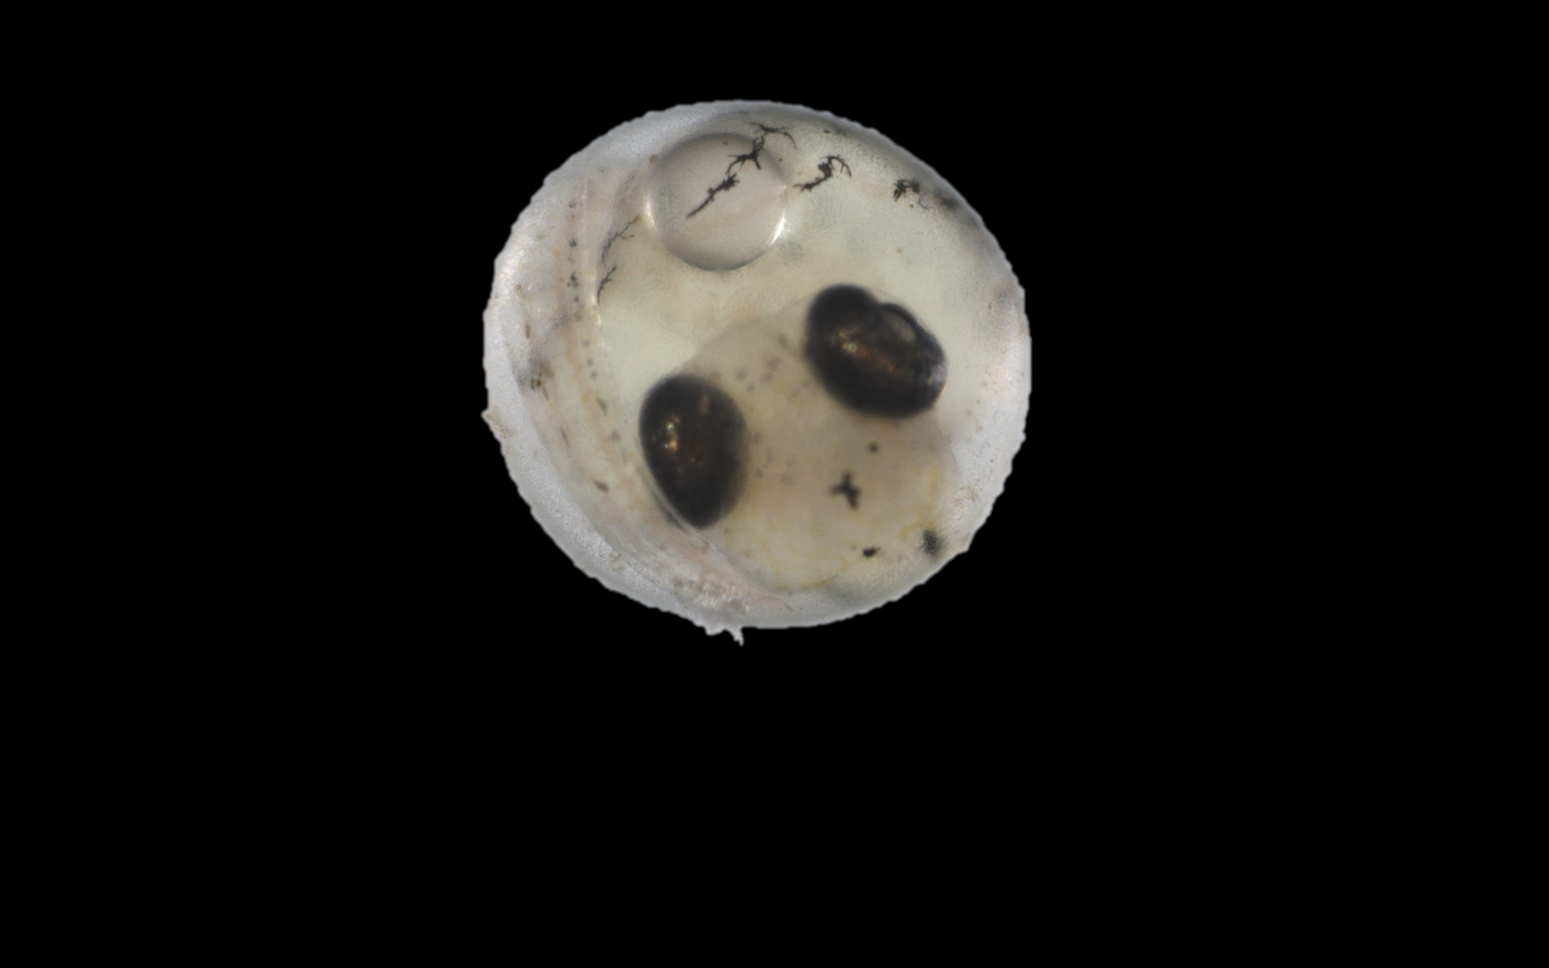
Ocean Acidification & Fish
CO₂
↓pH
Cellular H⁺ removal
Greater sensitivity?
No gills or incomplete

Slide 34
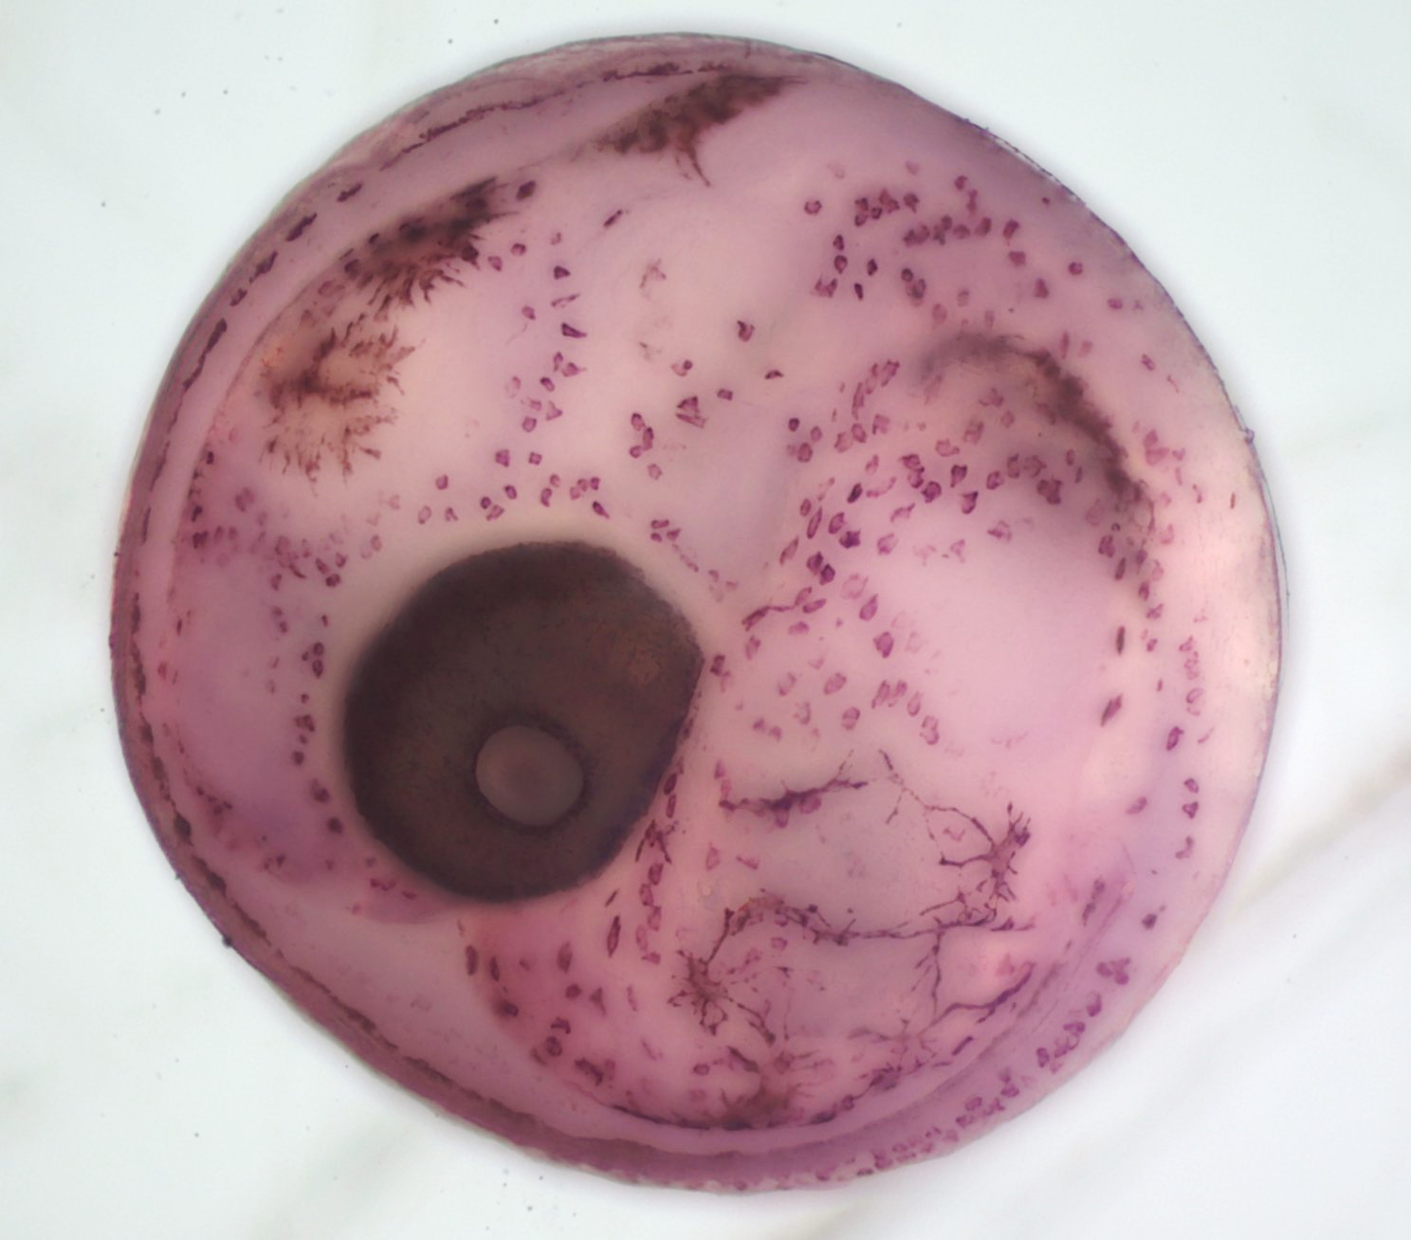
Chapter 3: Ionoregulatory responses to seawater acidification and temperature
What is an ionocyte?
Atlantic silverside embryo

Slide 35
Chapter 3: Ionoregulatory responses to seawater acidification and temperature
Ionocytes (purple)
Pigment
What is an ionocyte?
Ionocytes on yolk sac
Eye
Pigment and ionocytes
Atlantic silverside embryo

Slide 36
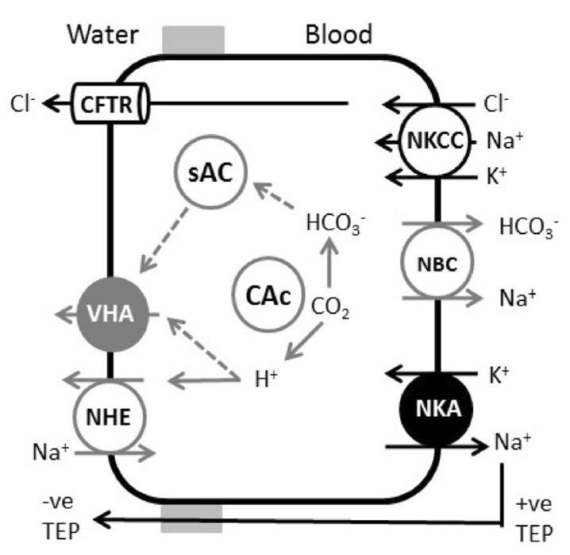
Ionocytes use energy
Active and passive transport proteins maintain ionic balance (salt and pH)
Esbaugh et al. (2018), J. Comp. Physiol. B.
Notes:
Ionocytes are...
They occur on the skin while the gills are still developing then just in the gills. They use various enzymes to transport ions with or against concentration gradients, which often uses energy.
I stained these using immunohistochemistry, with an antibody that binds to the enzyme Na/K ATPase, and then count the abundance of cells per unit area.

Slide 37
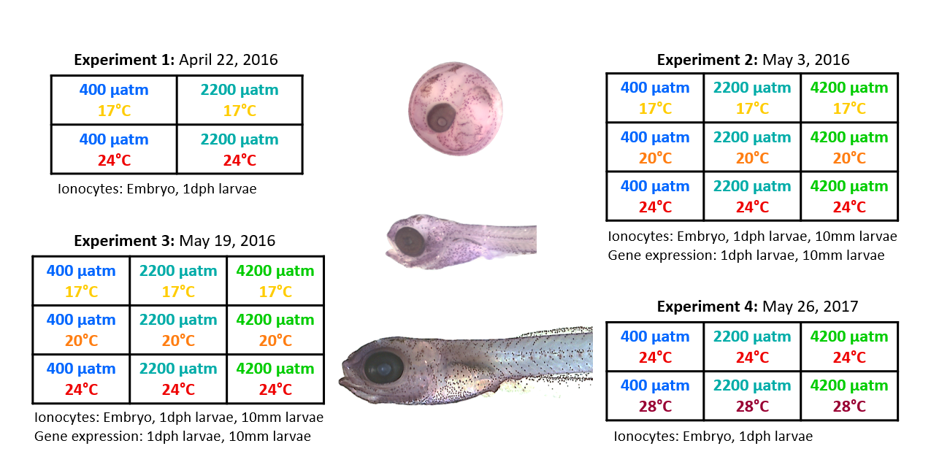
Experimental Design
Notes:
Ionocytes are...
They occur on the skin while the gills are still developing then just in the gills. They use various enzymes to transport ions with or against concentration gradients, which often uses energy.
I stained these using immunohistochemistry, with an antibody that binds to the enzyme Na/K ATPase, and then count the abundance of cells per unit area.

Slide 38
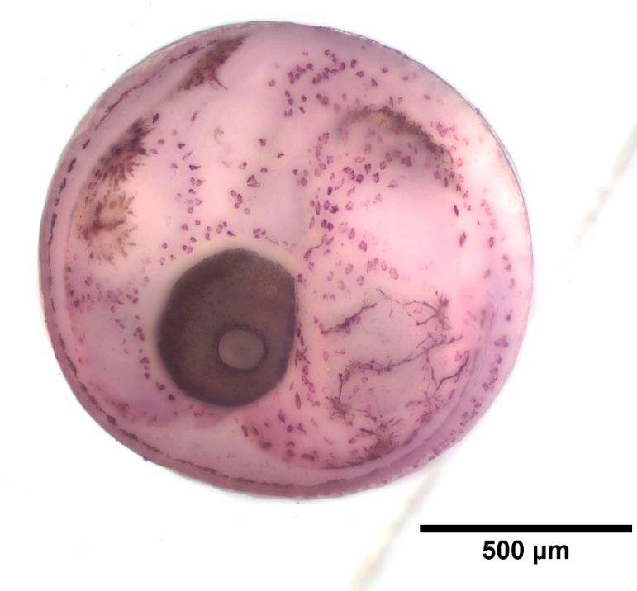
Embryos
Analyzed yolk sac separately

Slide 39
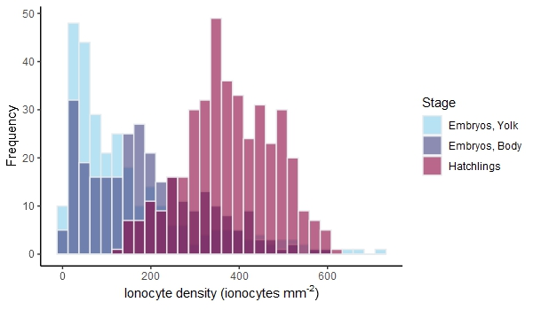
Chapter 3 Results: Density increases after hatching
Most embryos have low ionocyte density, but a few have very high
After hatching, ionocyte density doubles and is more symmetrically distributed

Slide 40
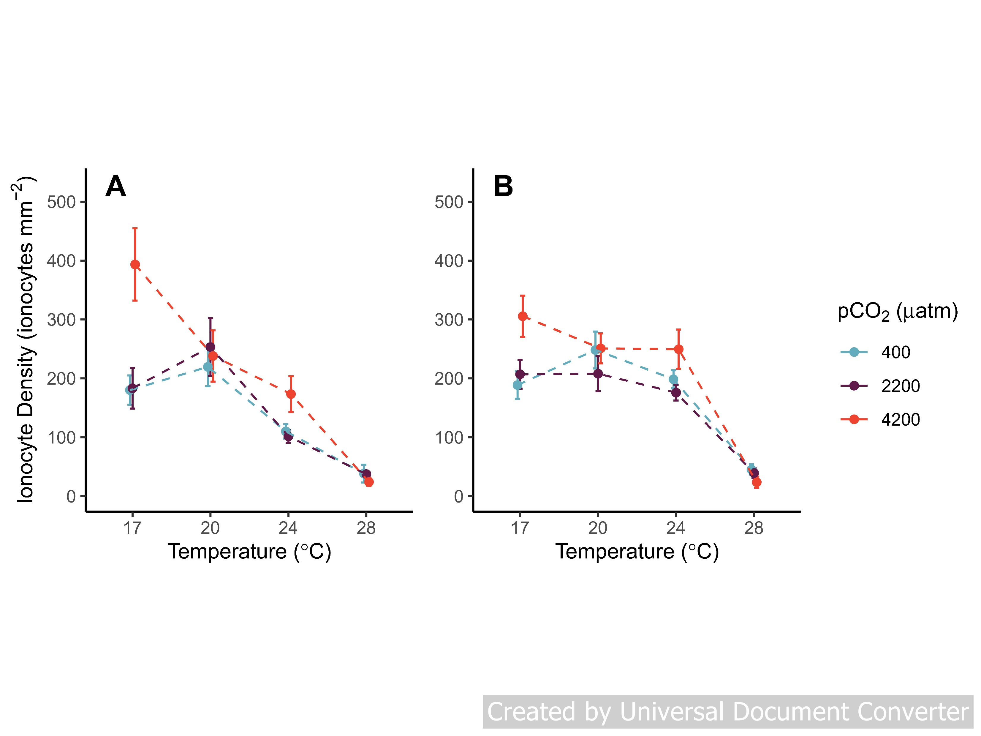
Chapter 3 Results: CO₂ and Temperature Interaction
Yolk Sac
Skin
Ionocyte density decreases as temperature goes up
At 17°C, ionocyte density increases at high CO₂
Stronger effect in yolk sac

Slide 41
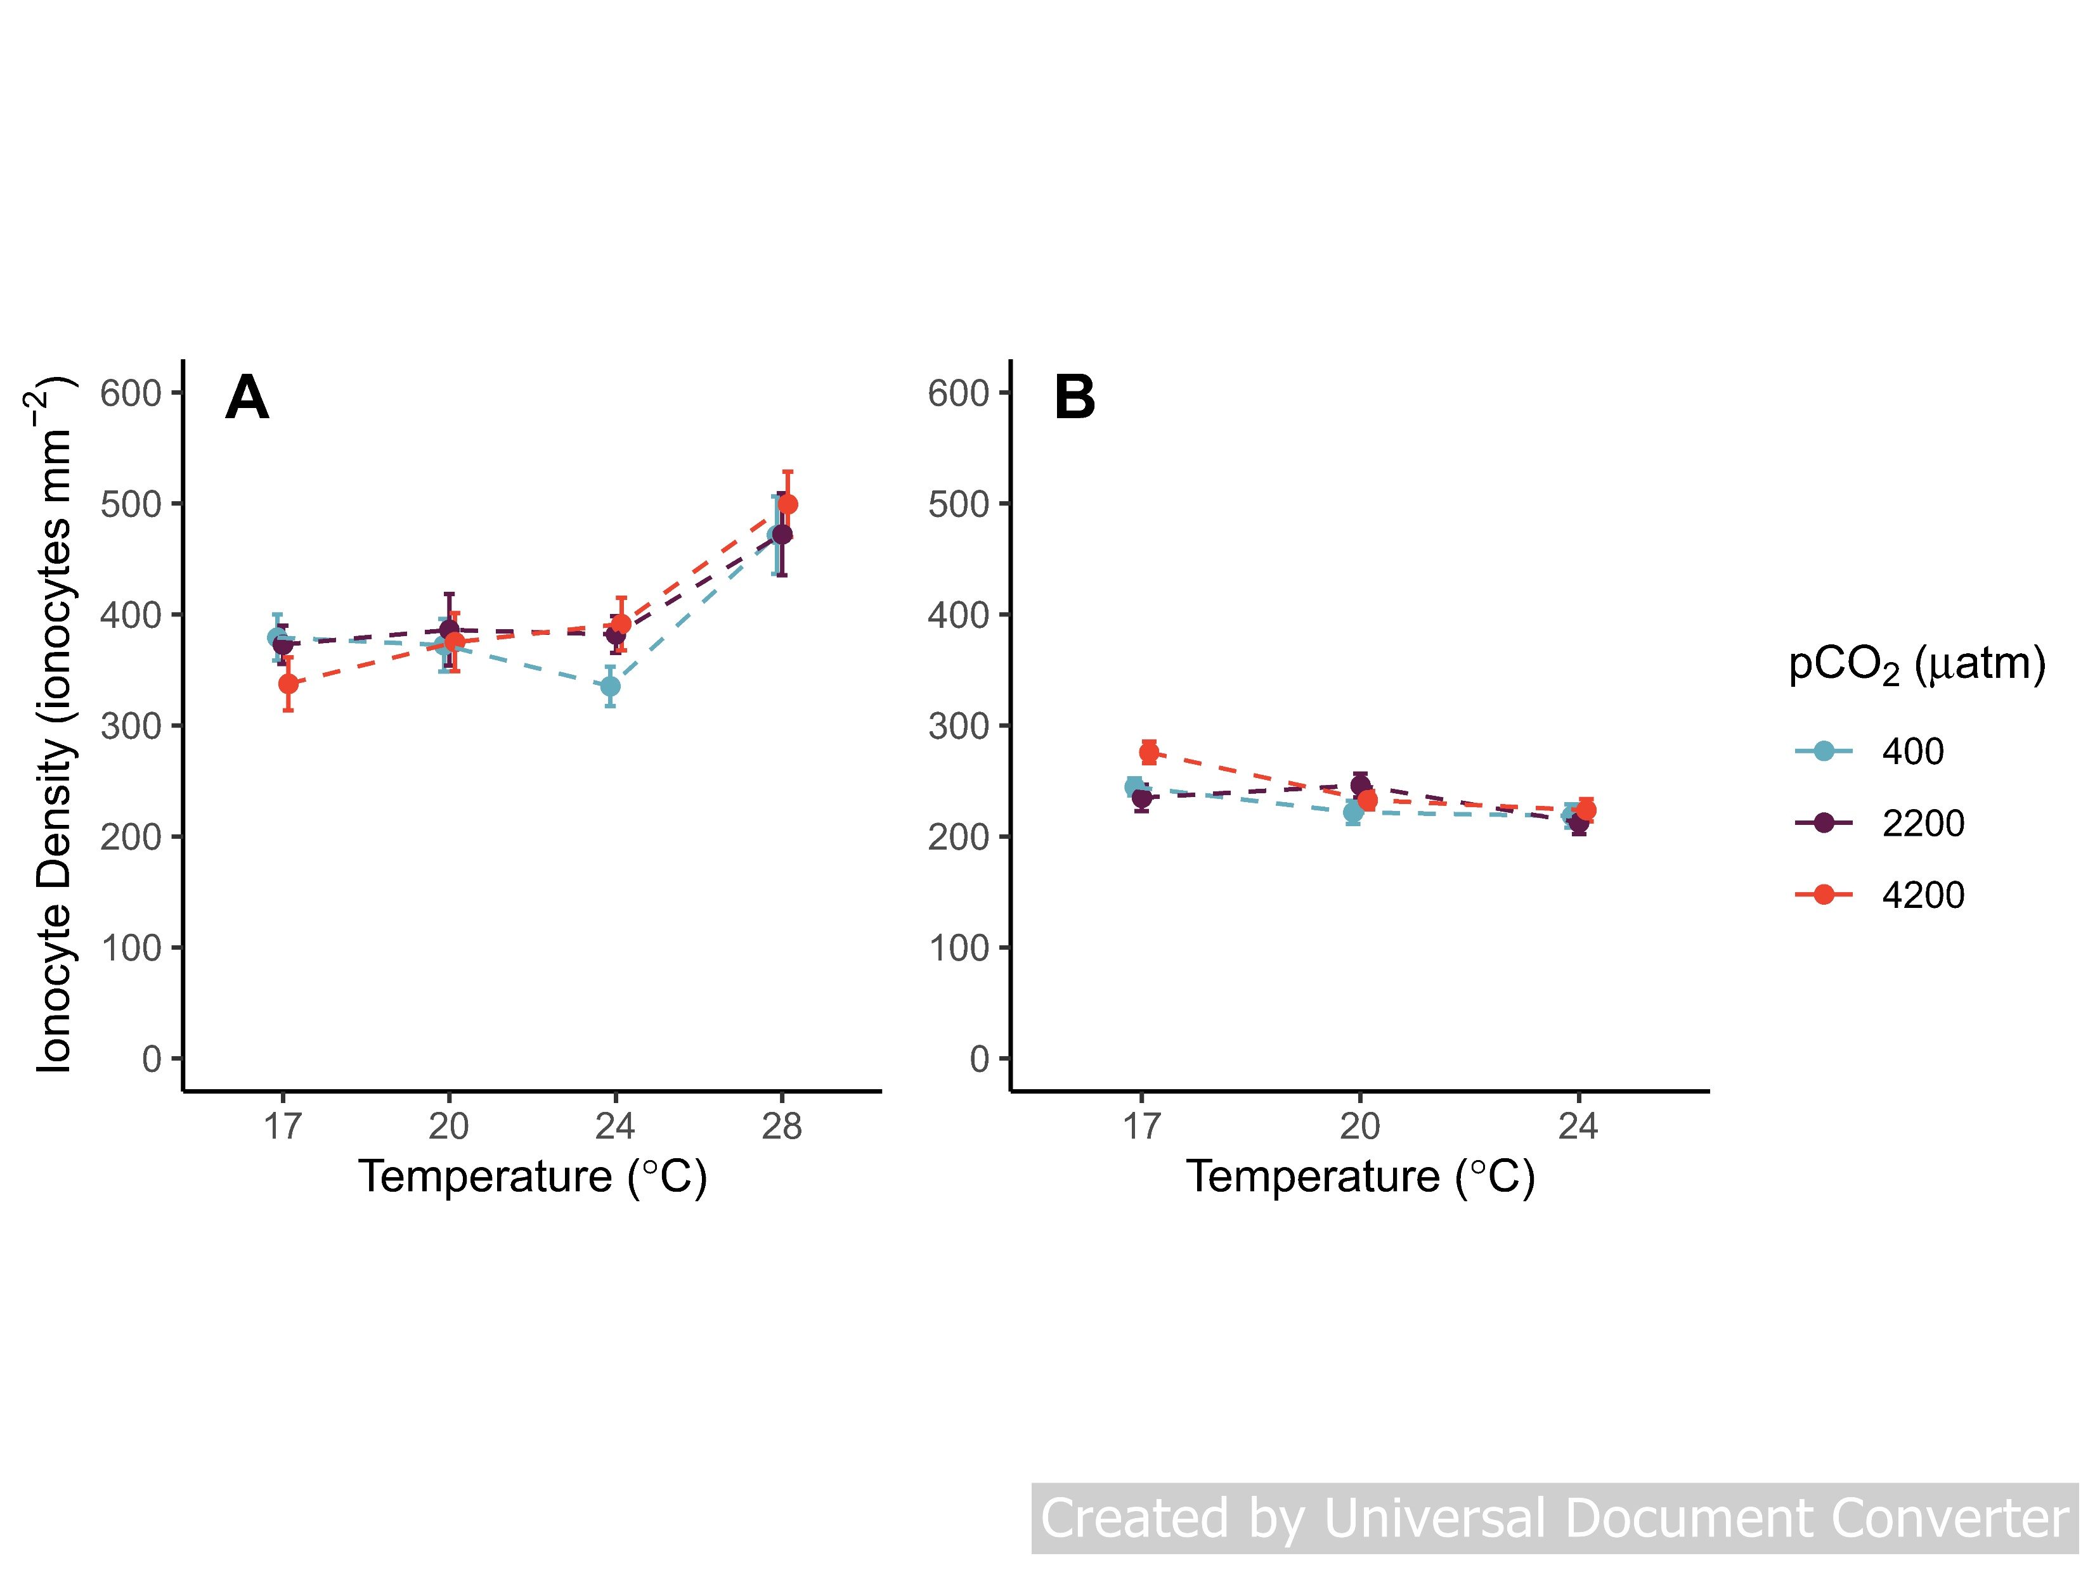
Chapter 3 Results: Larval ionocyte density
Hatchlings
10-mm Larvae
Hatchling ionocyte density increases with temperature
At 24°C ionocyte density increases slightly with CO₂
By 10-mm length, no treatment effects and lower overall ionocyte density

Slide 42
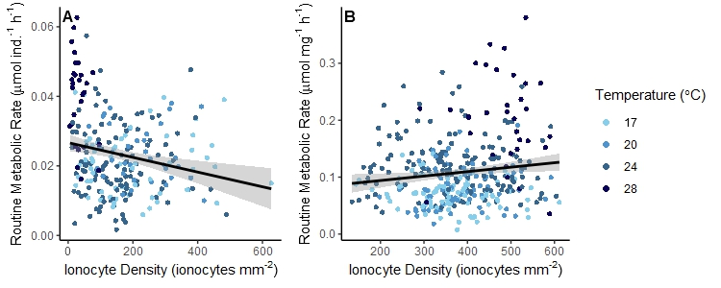
Chapter 3 Results: Does metabolism increase with ionocyte density?
Embryos
Hatchlings
R² = 0.04
R² = 0.02
Relationship switches after hatching
Temperature is strongest factor in both: metabolism and ionocytes

Slide 43
Chapter 3 Conclusions and Next Steps
Temperature influences how well silversides can adjust to high CO₂
Ionocytes proliferate rapidly around time of hatching
May also be a survival effect
Future steps: confirm ionocyte activity
In progress: Gene expression
Future work: Enzyme activity
Notes:
-The low ionocyte density before hatching compared to after may be related to the difference in metabolic sensitivity before and after hatching
-Maybe since they have fewer ionocytes they are doing more with each ionocyte to maintain acid-base balance

Slide 44
Outline
Chapter 1: Measure metabolic effects of CO₂, temperature, and oxygen treatments
Chapter 2: Does acidification alter metabolic response to progressive, acute hypoxia?
Chapter 3: Identify mechanism of pH regulation in early life stages across CO₂ and temperature levels
Chapter 4: Attribute early life hypoxia responses to energetic mechanisms using a Dynamic Energy Budget

Slide 45
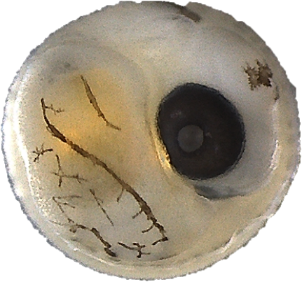
Chapter 4: Attributing hypoxia responses to energetic mechanisms with DEB model
Objectives
Understand energetic costs and mechanisms of hypoxia, which can interact with other stressors
Use a model that can connect to population level

Slide 46
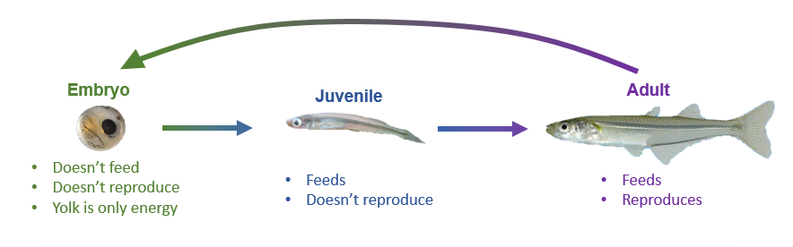
Dynamic Energy Budget (DEB) model
Life stage specific energy sources and costs

Slide 47
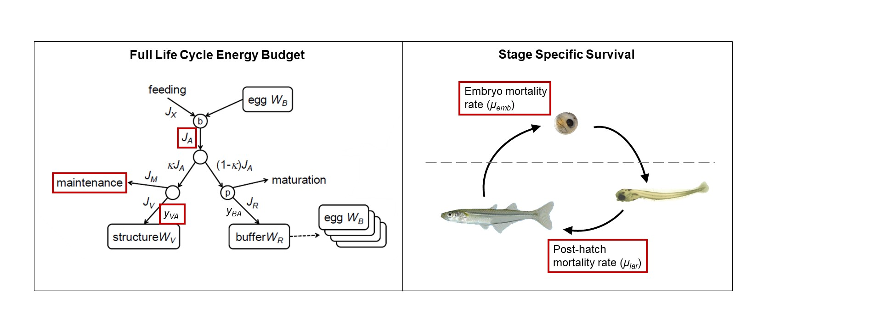
DEBkiss A simplified type of DEB model
Fewer parameters
No ‘reserve’
Units of mass instead of energy

Slide 48
DEBkiss A simplified type of DEB model

Slide 49
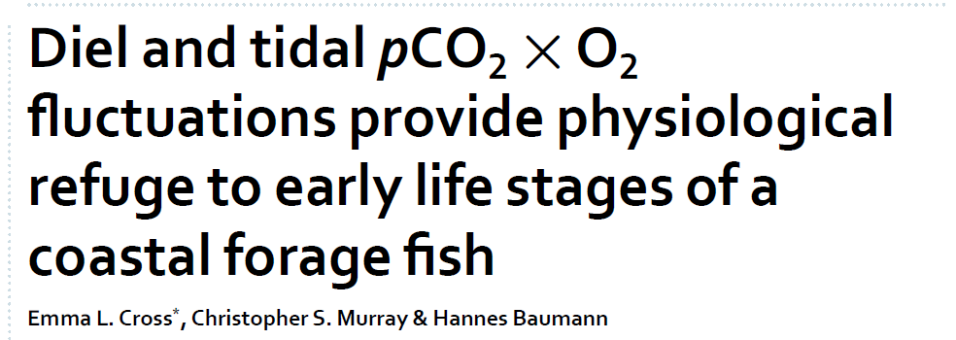
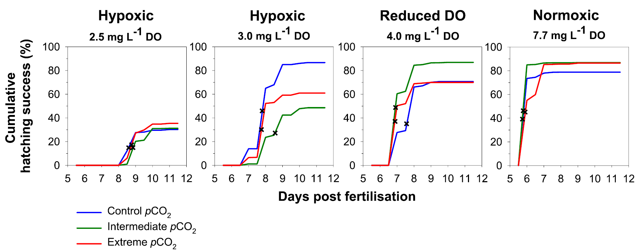
Previous study on hypoxia effects
Cross et al., 2019, Scientific Reports

Slide 50
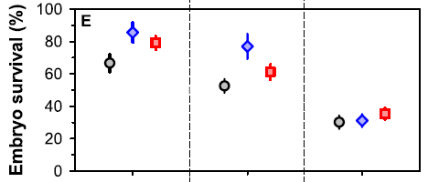
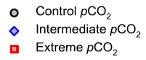
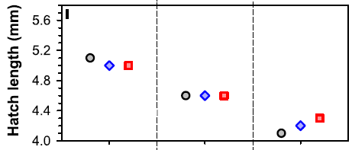
Previous study on hypoxia effects
Delayed hatching
Reduced hatch and post-hatch survival
Smaller hatch size
Slower growth
All suggest changes to energy allocation
Cross et al., 2019, Scientific Reports

Slide 51
Chapter 4 Hypotheses
Hypotheses
Feeding often declines in hypoxia, but embryos don’t feed so this doesn’t account for embryo effects
Assimilation or conversion efficiency
Maintenance
Survival parameters
Notes:
-Survival doesn’t reveal as much about the energy budget exactly but it does still have implications for recruitment to the adult population, which then affects how many adults there are to reproduce

Slide 52
DEBkiss A simplified type of DEB model

Slide 53
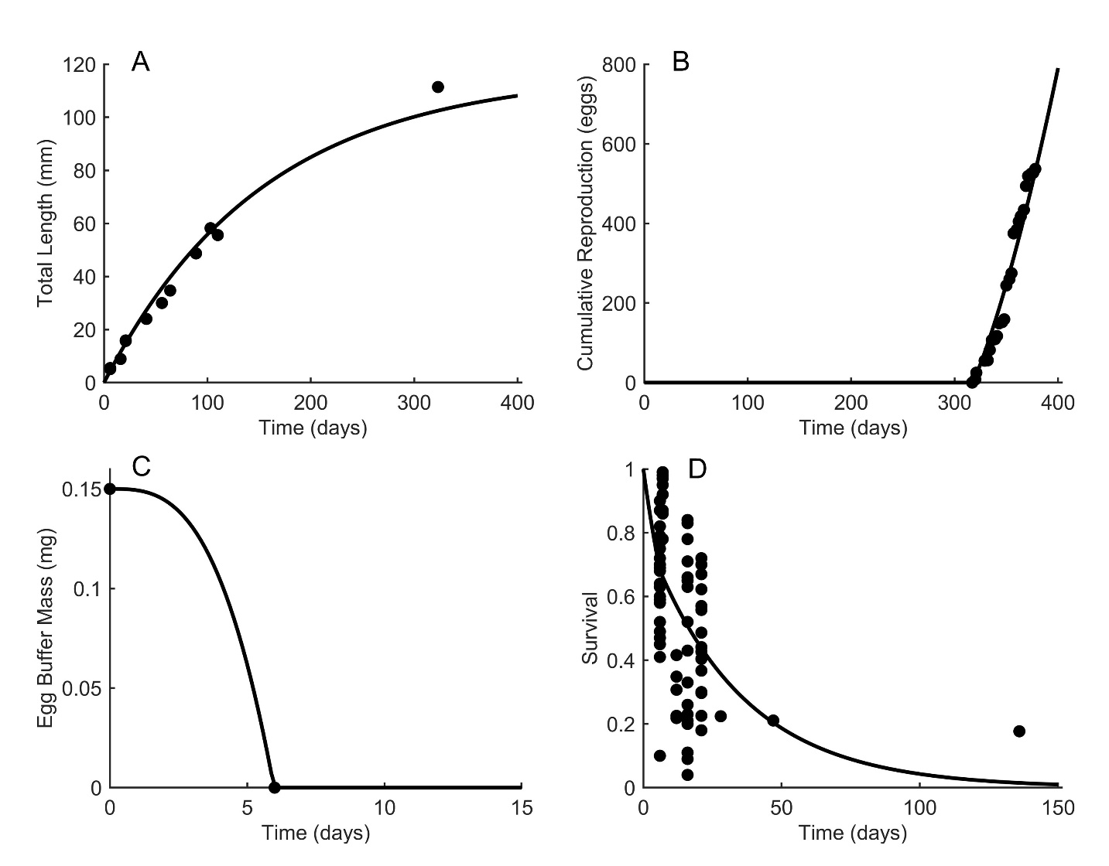
First estimate parameters for M. menidia using four types of data:
Total length
Reproduction
Egg buffer mass
Survival

Slide 54
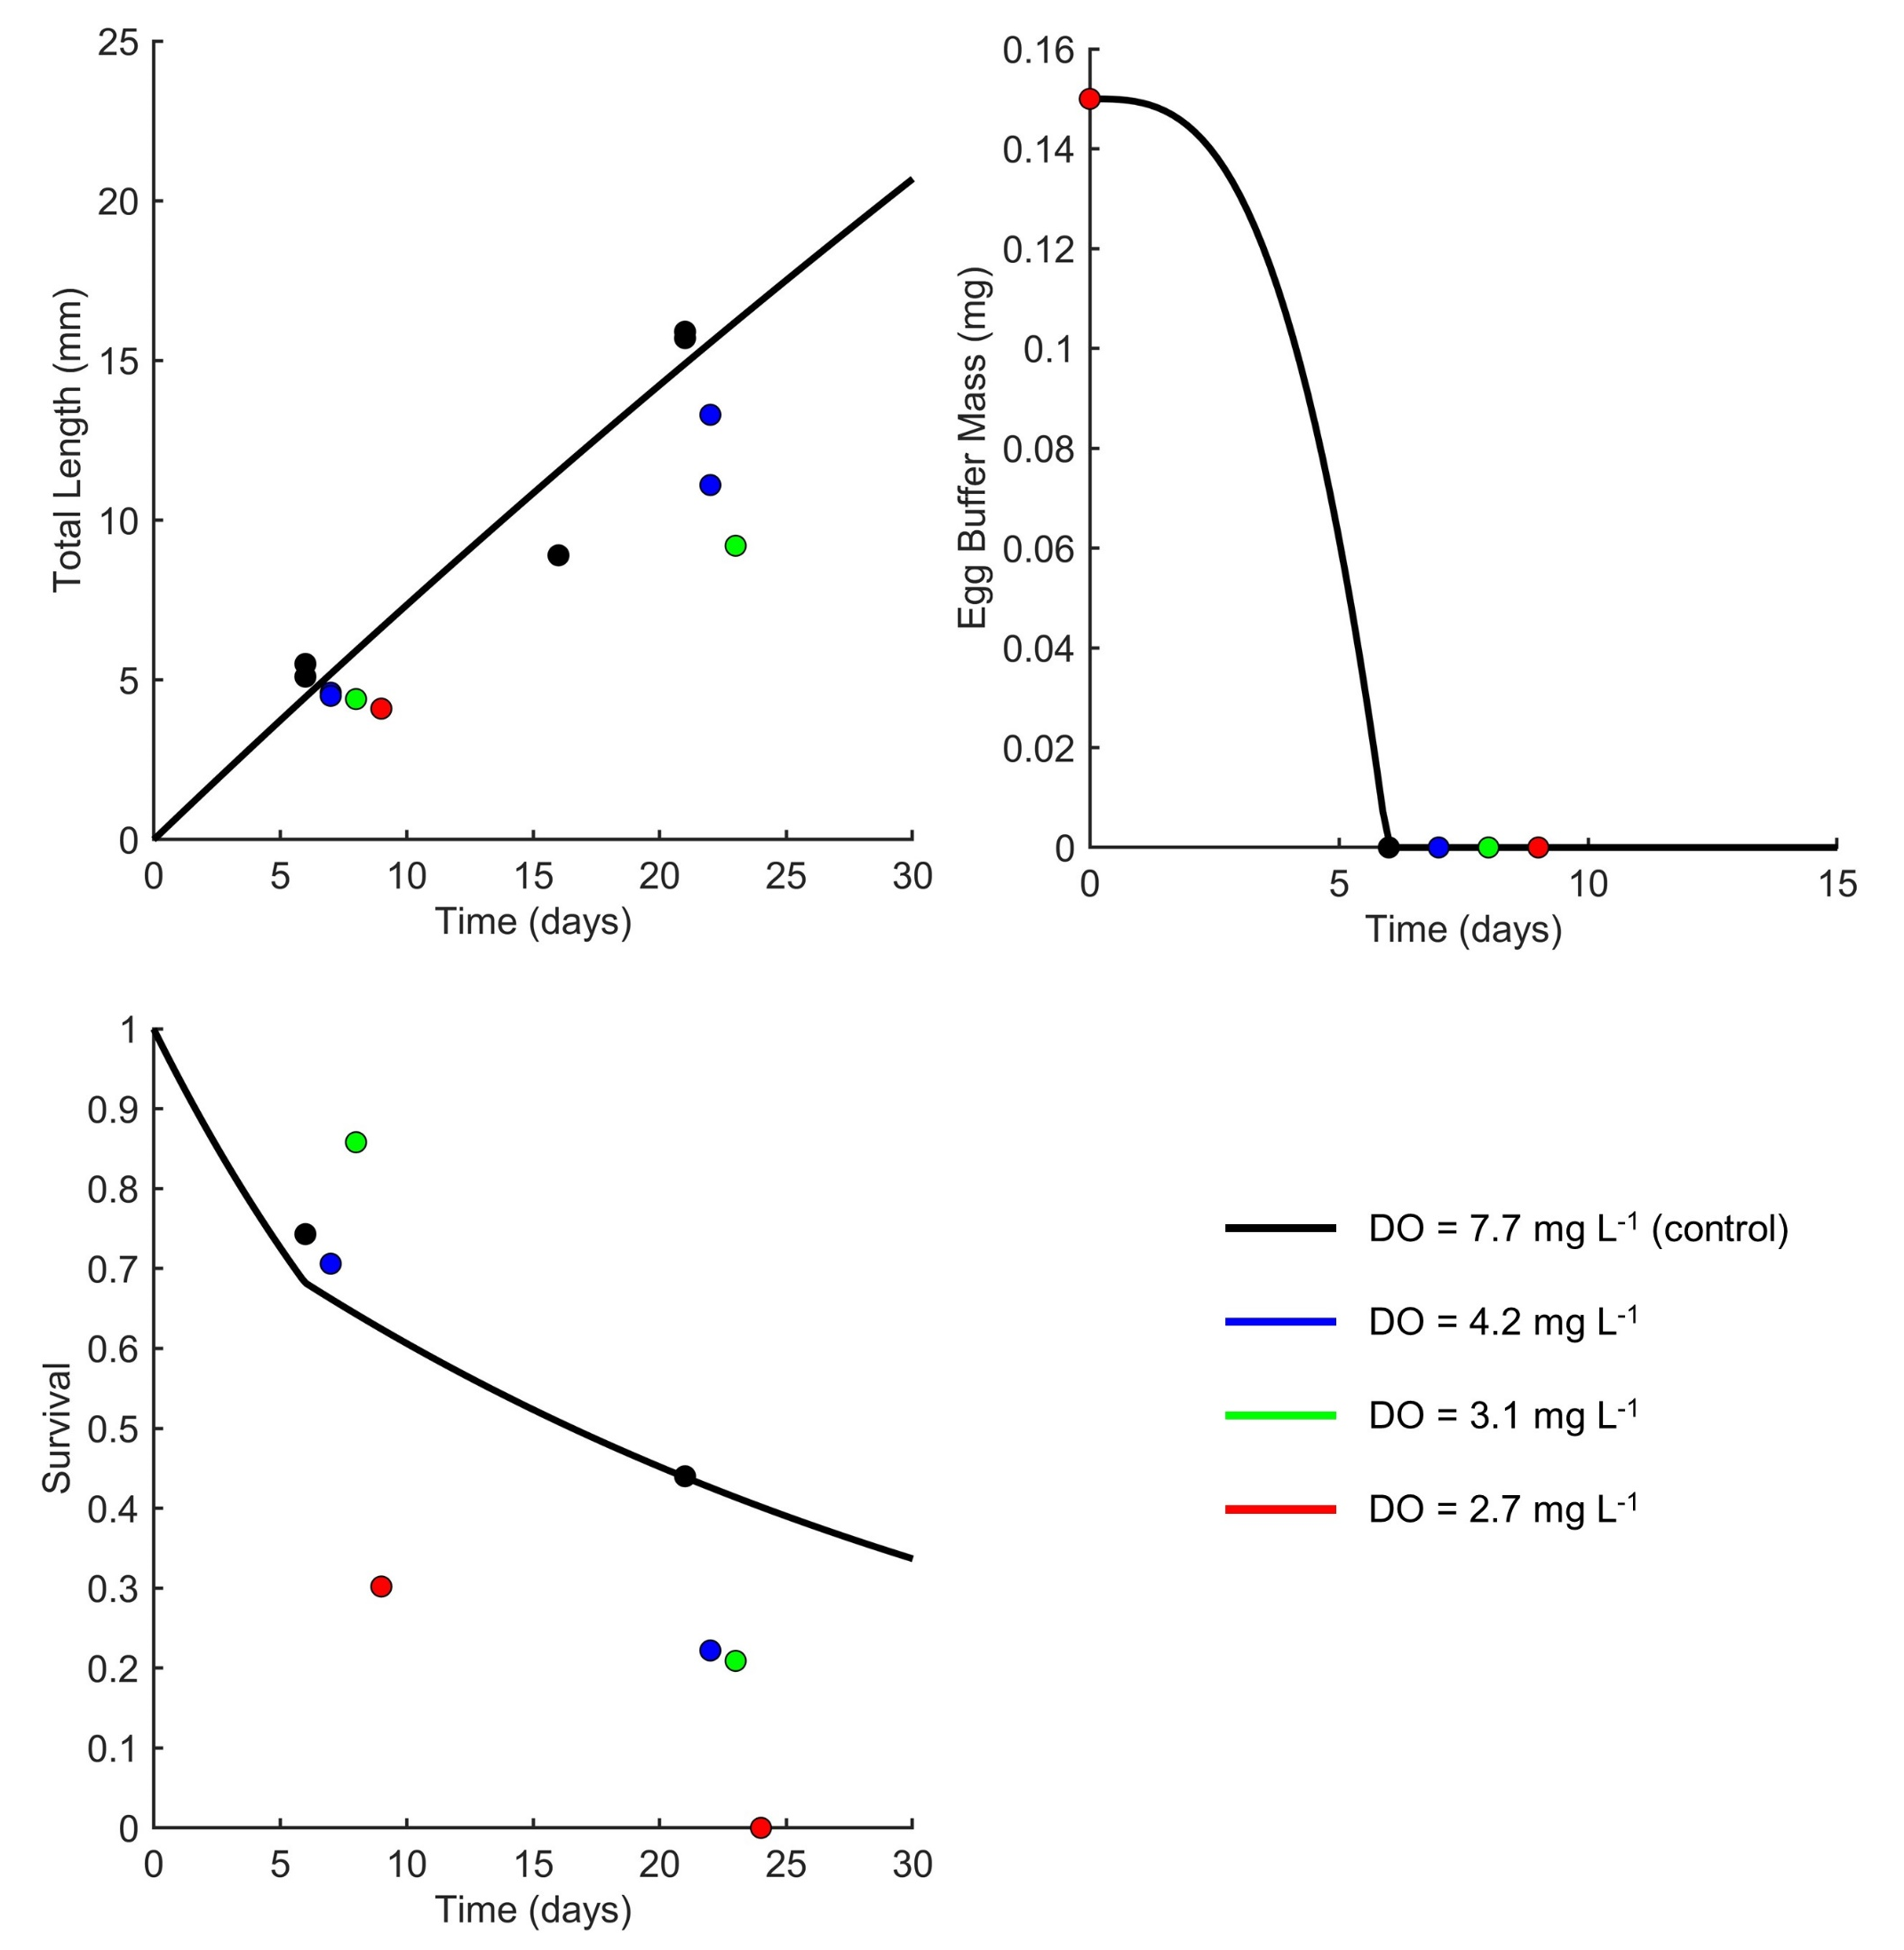
Then ask:
What parameters can we change to get the predicted line closer to the observed points?

Slide 55
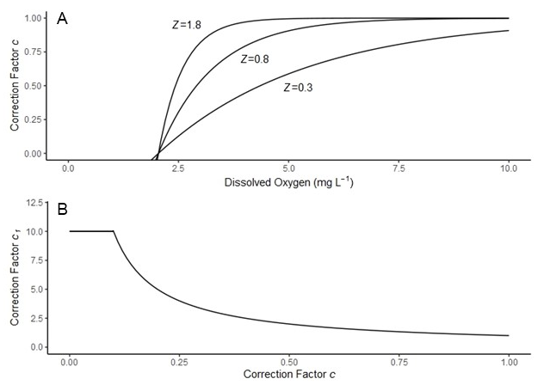
Correction factors that increase or decrease a parameter as oxygen gets lower
The exponential coefficient determines how strong of an effect hypoxia has on the parameter (how flat or curved the shape is)

Slide 56
Parameter(s) affected by hypoxia | Correction factor(s) | Estimated Z [95% CI] | AICc | ΔAICc | Akaike weight
Jª_{Am} | c | 1.70 [1.69-2.70] | 600.73 | 16.08 | 1.16e-4
y_{VA} | c | 1.48 [1.20-3.21] | 602.38 | 17.73 | 5.07e-5
J^{v}_{M} | c₁ | 0.365 [0.302-0.5178] | 599.42 | - | -
μ_{emb} | c₁ | 0.626 [0.435-0.992] | 585.76 | - | -
μ_{lar} | c₁ | 0.303 [0.201-0.492] | 575.06 | - | -
Jª_{Am} + J^{v}_{M} | c + c₁ | 1.72 [1.72-2.69] | 600.65 | 16.00 | 1.20e-4
y_{VA} + J^{v}_{M} | c + c₁ | 1.47 [1.22-3.08] | 602.23 | 17.58 | 5.46e-5
J^{v}_{M} + μ_{emb} | c₁ + c₁ | 0.520 [0.374-0.851] | 582.83 | - | -
Jª_{Am} + μ_{emb} | c + c₁ | 1.70 [1.69-2.04] | 590.30 | 5.95 | 0.0213
y_{VA} + μ_{emb} | c + c₁ | 1.31 [1.20-1.78] | 589.29 | 4.64 | 0.0353
J^{v}_{M} + μ_{lar} | c₁ + c₁ | 0.354 [0.299-0.448] | 568.13 | - | -
Jª_{Am} + μ_{lar} | c + c₁ | 1.70 [1.69-2.25] | 595.45 | 10.80 | 0.00162
y_{VA} + μ_{lar} | c + c₁ | 1.34 [1.20-1.98] | 594.67 | 10.02 | 0.00239
μ_{emb} + μ_{lar} | c₁ + c₁ | 0.766 [0.543-1.15] | 580.11 | - | -
Jª_{Am} + μ_{emb} + μ_{lar} | c + c₁ + c₁ | 1.70 [1.69-2.02] | 586.75 | 2.10 | 0.126
y_{VA} + μ_{emb} + μ_{lar} | c + c₁ + c₁ | 1.32 [1.20-1.76] | 584.78 | 0.13 | 0.336
J^{v}_{M} + μ_{emb} + μ_{lar} | c₁ + c₁ + c₁ | 0.712 [0.482-1.09] | 578.82 | - | -
Jª_{Am} + J^{v}_{M} + μ_{emb} + μ_{lar} | c + c₁ + c₁ + c₁ | 1.72 [1.72-2.04] | 586.86 | 2.21 | 0.119
y_{VA} + J^{v}_{M} + μ_{emb} + μ_{lar} | c + c₁ + c₁ + c₁ | 1.31 [1.22-1.75] | 584.65 | 0 | 0.359

Slide 57
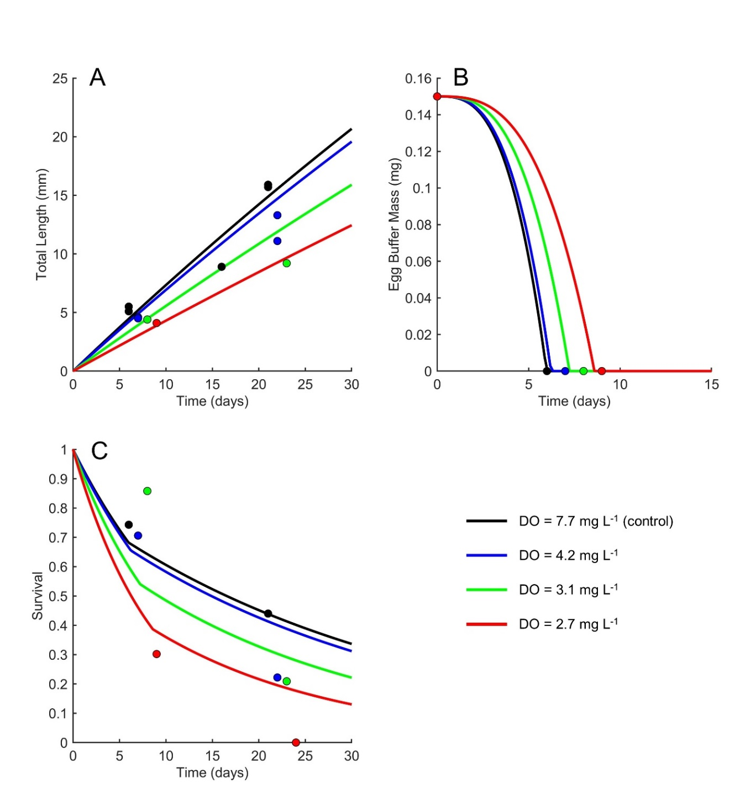
Chapter 4 Results
Best fit applies correction factors to:
Conversion efficiency of assimilates to growth
Pre- and post-hatch survival
Conversion efficiency alone has some effect on total length, hatch timing, and survival

Slide 58
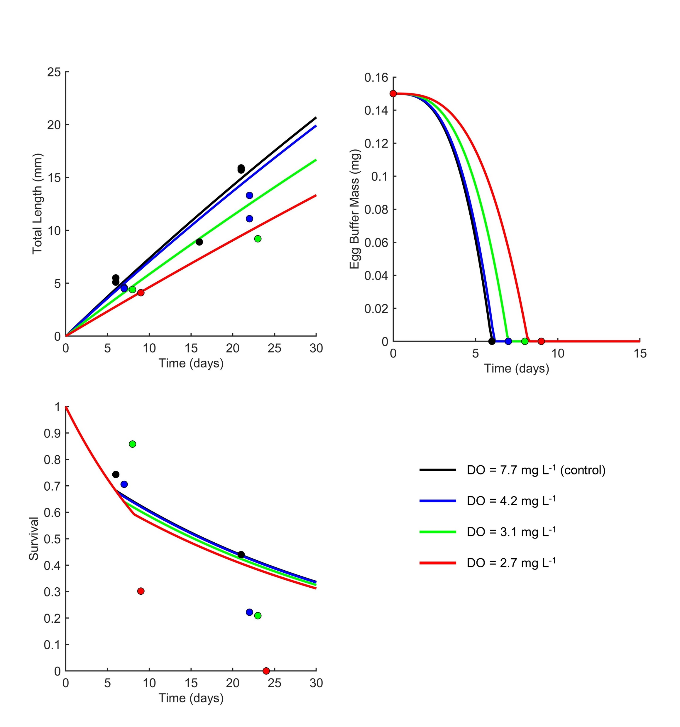
Chapter 4 Results
Applying correction factor to conversion efficiency only
Best fit applies correction factors to:
Conversion efficiency of assimilates to growth
Pre- and post-hatch survival
Conversion efficiency alone has some effect on total length, hatch timing, and survival

Slide 59
Calculated parameter values at each oxygen level
 | Product of correction factor and initial parameter value
 | 7.7 mg L⁻¹ | 4.2 mg L⁻¹ | 3.1 mg L⁻¹ | 2.7 mg L⁻¹
Conversion efficiency | 0.364 | 0.343 | 0.274 | 0.211
Pre-hatch mortality | 0.175 | 0.186 | 0.234 | 0.303
Post-hatch mortality | 0.0807 | 0.0856 | 0.107 | 0.139
Notes:
At lowest DO level, conversion efficiency is 58% of what it was at normoxia,
And mortality rates are 1.73 times higher (or 73% greater)

Slide 60
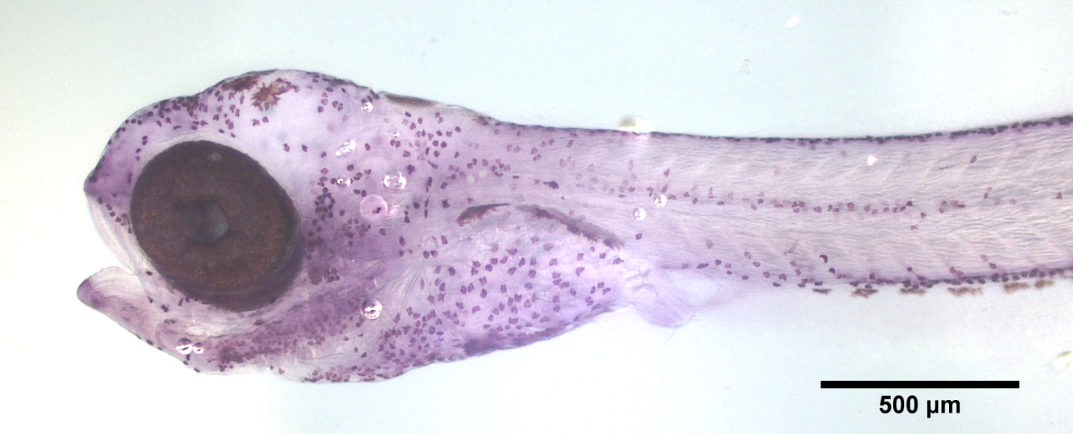
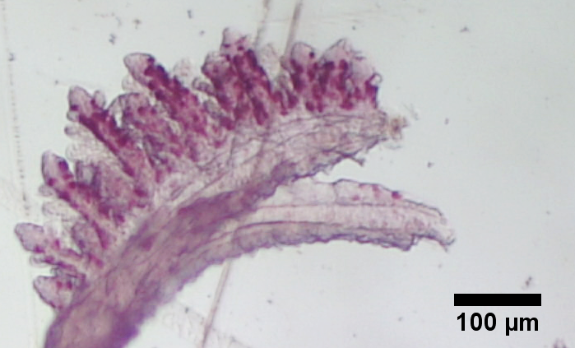
Chapter 4 Conclusions
Reduced conversion efficiency may result from less efficient ATP production by anaerobic metabolism
Implications for development, ultimate size, and food needs
Mortality parameters – suggest other physiological mechanisms not accounted for by DEB model
Maintenance was not a likely mechanism of hypoxia effects
Slower differentiation of cells → slower ionocyte and gill development?

Slide 61
Chapter 4 Next Steps
Ocean acidification interaction
Apply to population growth
M. menidia is a model species – apply methods to another species

Slide 62
Objectives
Chapter 1: Measure metabolic effects of CO₂, temperature, and oxygen treatments
Chapter 2: Does acidification alter metabolic response to progressive, acute hypoxia?
Chapter 3: Identify mechanism of pH regulation in early life stages across CO₂ and temperature levels
Chapter 4: Attribute early life hypoxia responses to energetic mechanisms using a Dynamic Energy Budget

Slide 63
Conclusions of Dissertation
Stage-specific sensitivity to interacting stressors
Variability across experiments – suggests species resilience
Growth
Ion exchange,
Metabolism

Slide 64
Conclusions of Dissertation
Stage-specific sensitivity to interacting stressors
Variability across experiments – suggests species resilience
Growth
Ion exchange,
Metabolism

Slide 65
Conclusions of Dissertation
Highly variable environment may prepare silversides for environmental change
E.g. larval hypoxia sensitivity (P_{crit}) decreased under high CO₂
Maintenance not a likely hypoxia mechanism – OA and hypoxia wouldn’t be simultaneously demanding energy from the same flux

Slide 66
Future Directions
Use DEB model to combine stressors and additional levels
Model population growth rate
Identify locations of greatly intensifying stressors
Competitive advantage for silversides?
Slower growth → greater risk of predation
Ecosystem level implications – food for higher trophic levels

Slide 67
Acknowledgements

